Slide 1
National Schools Twenty20 competition
Finals day June 28th 2018
Arundel Castle

Slide 2
Photographs
by
Patrick Eagar
© No images may be reproduced without permission

Slide 3
The first semi-final
Sedbergh v Millfield
Sedbergh in brown
Millfield in light blue

Slide 4
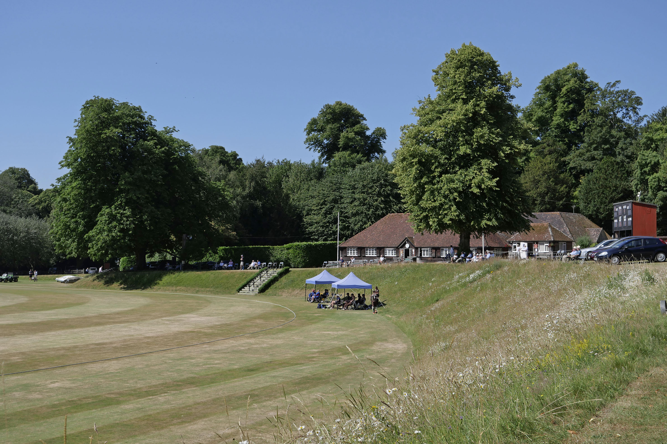
A lovely setting on a nice June summer’s day

Slide 5
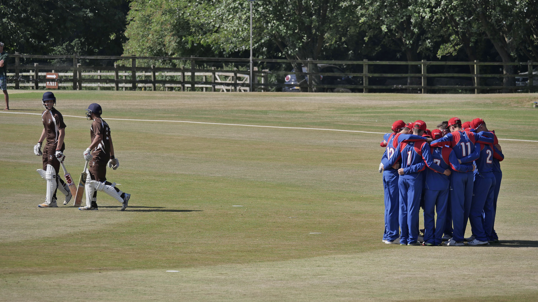
Semi final Millfield v Sedbergh, The Sedbergh openers pass the Millfield huddle.

Slide 6
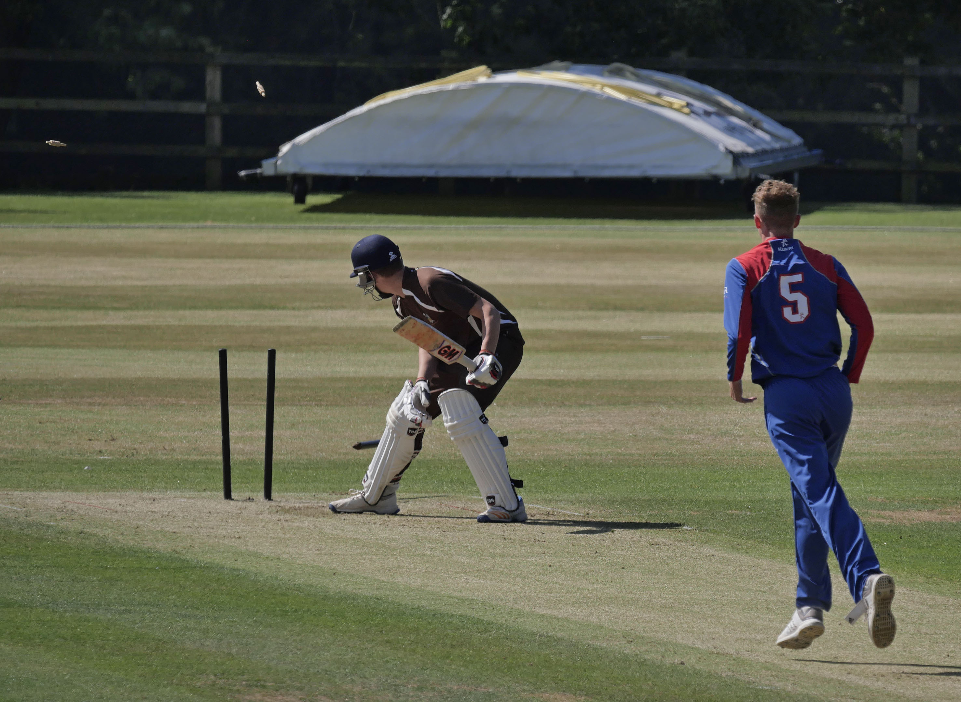
Sam Barratt is bowled by Julius Sumerauer for 10.

Slide 7
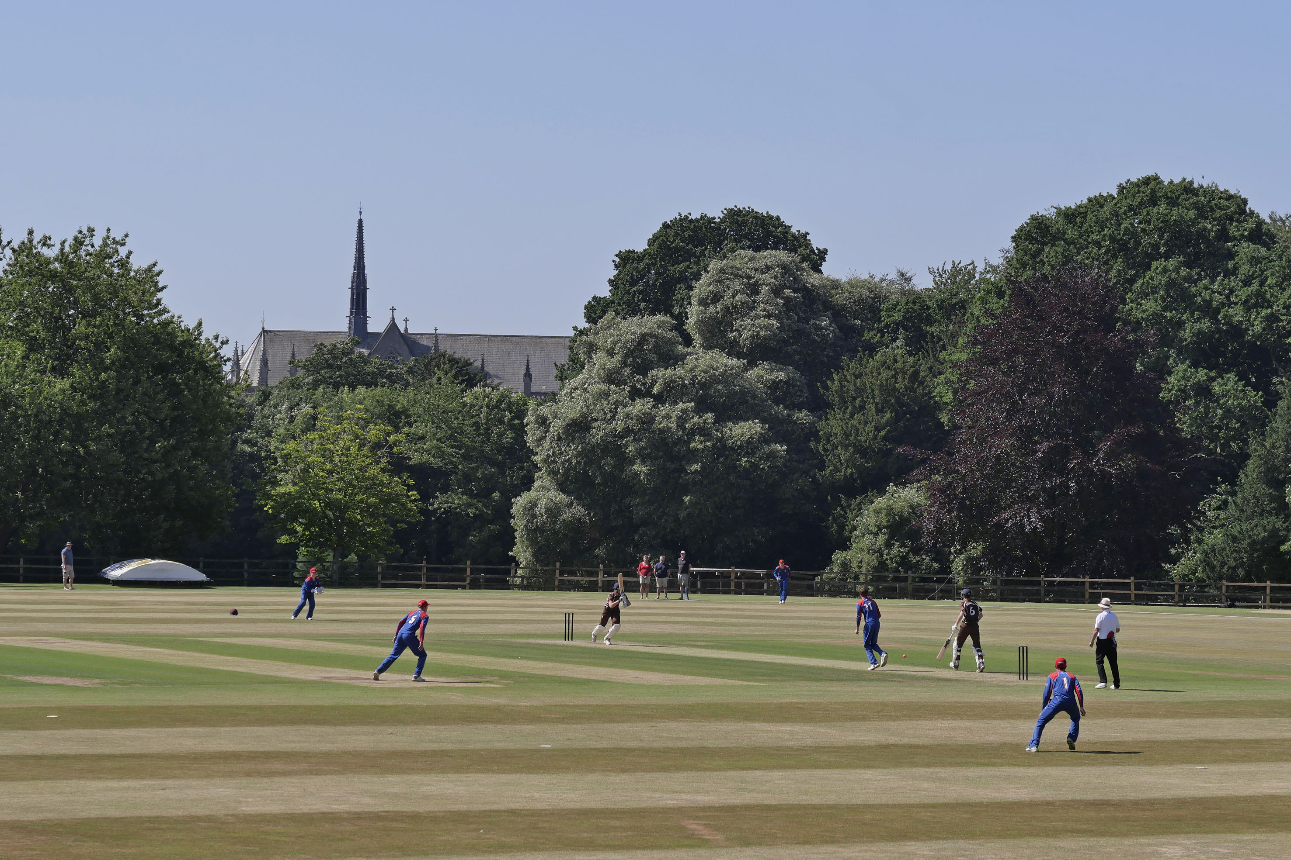
Semi final Millfield v Sedbergh.

Slide 8
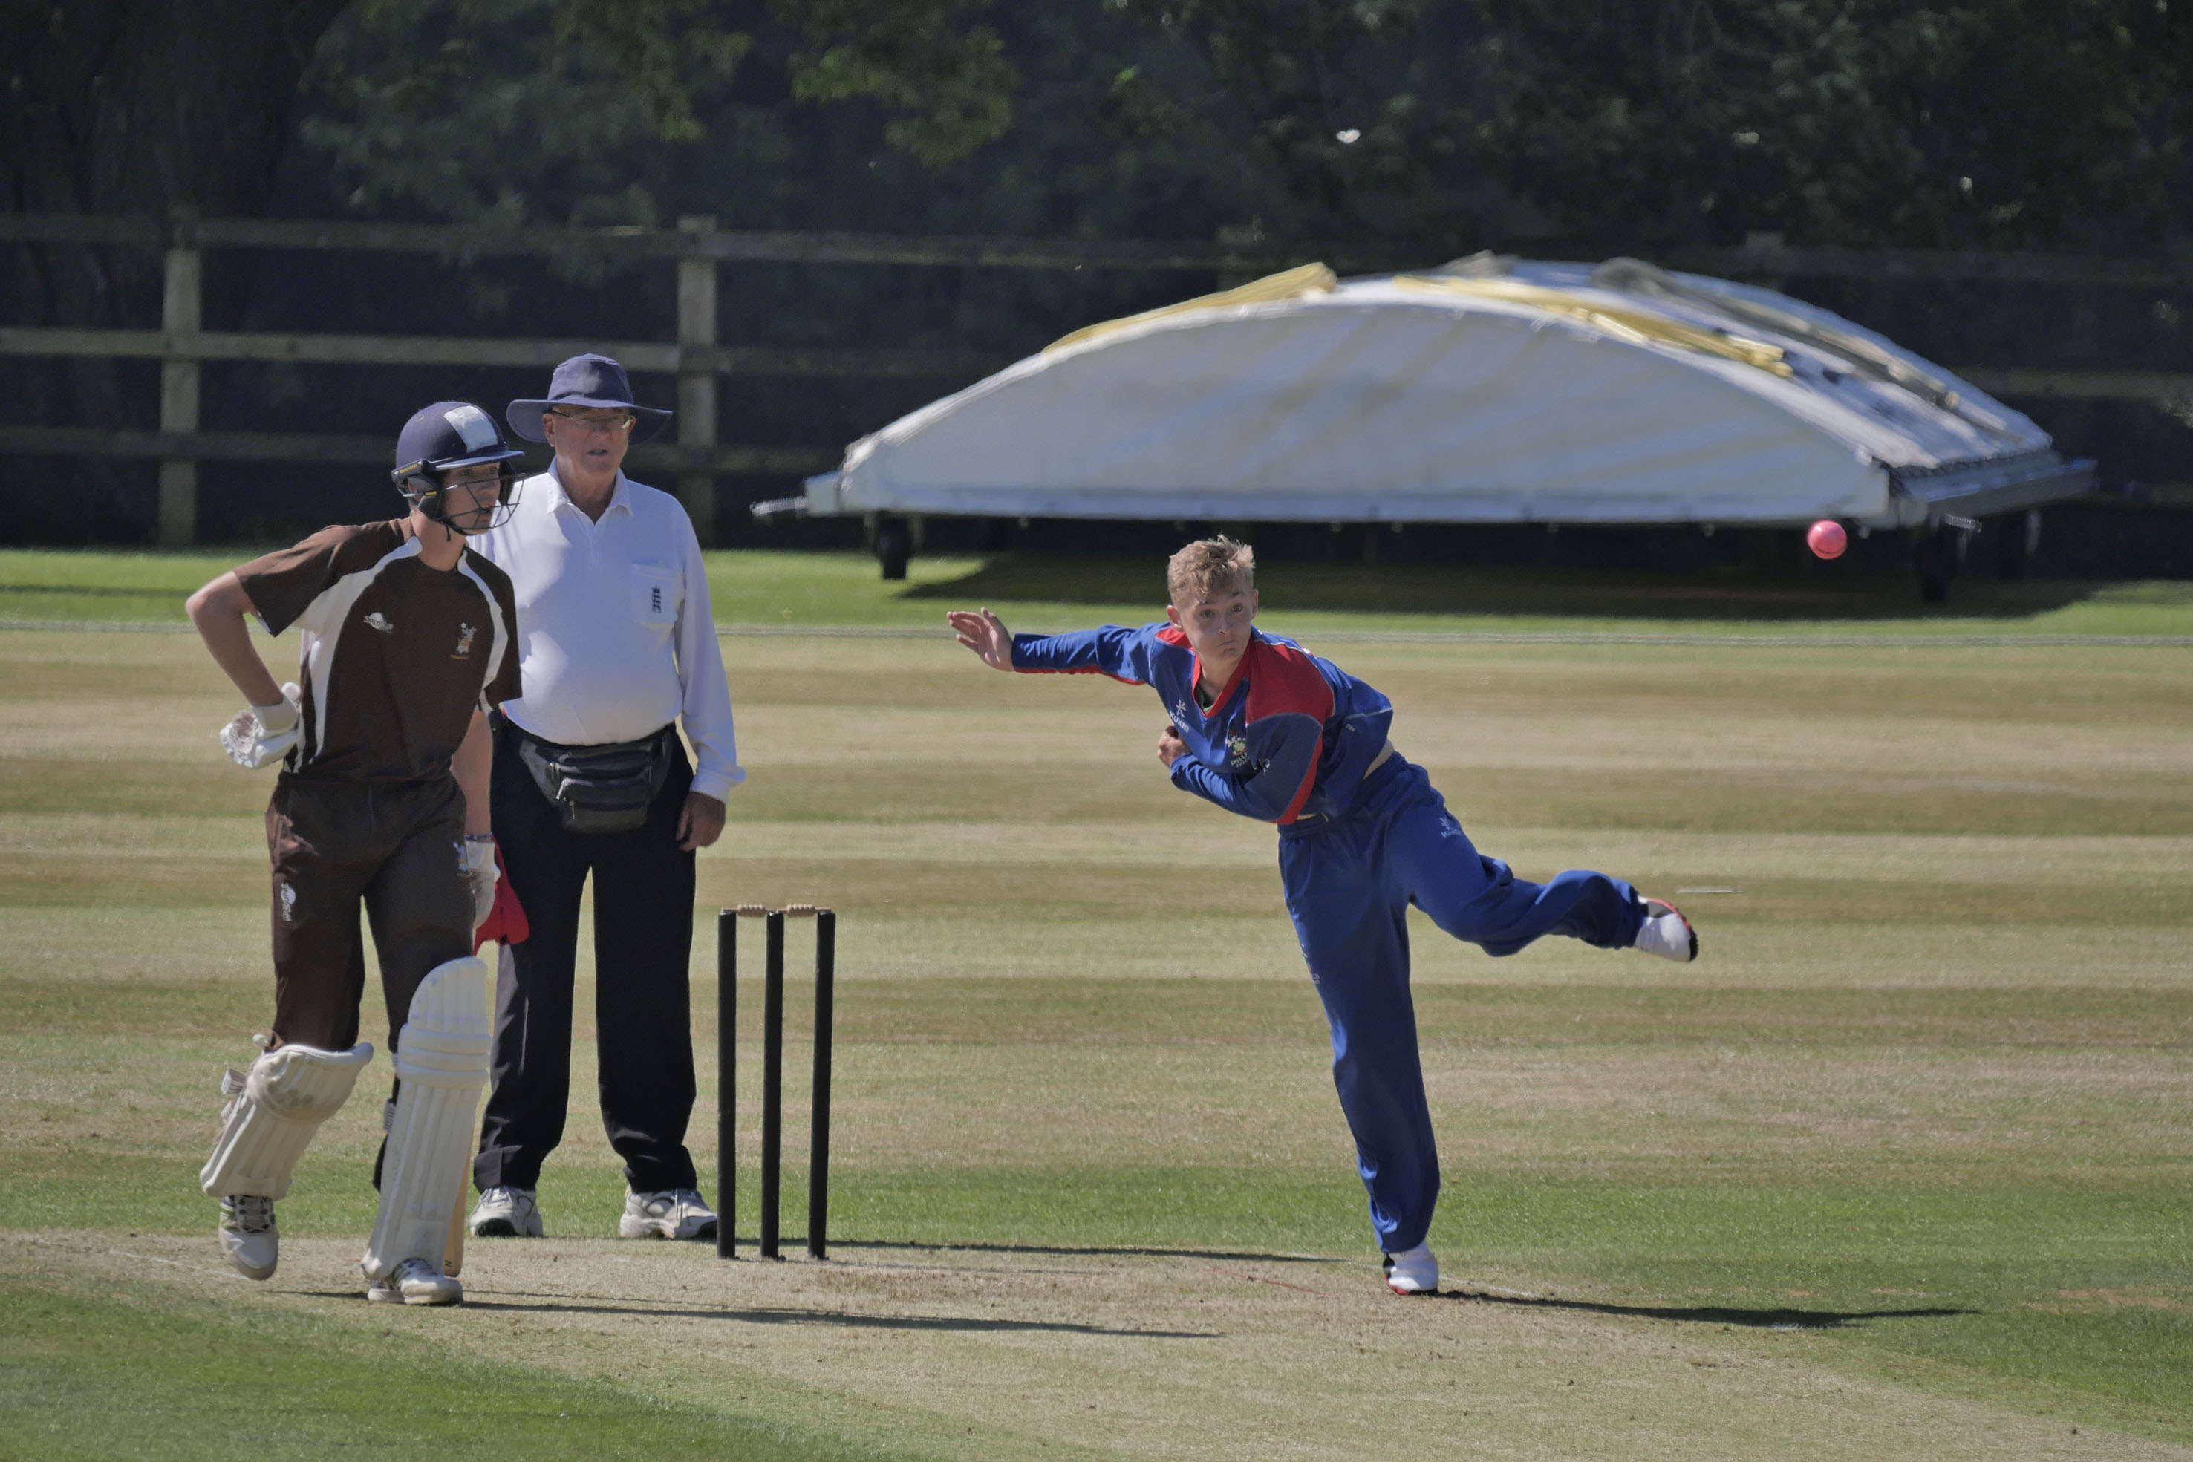
Semi final Millfield v Sedbergh: Lewis Goldsworthy bowling.

Slide 9
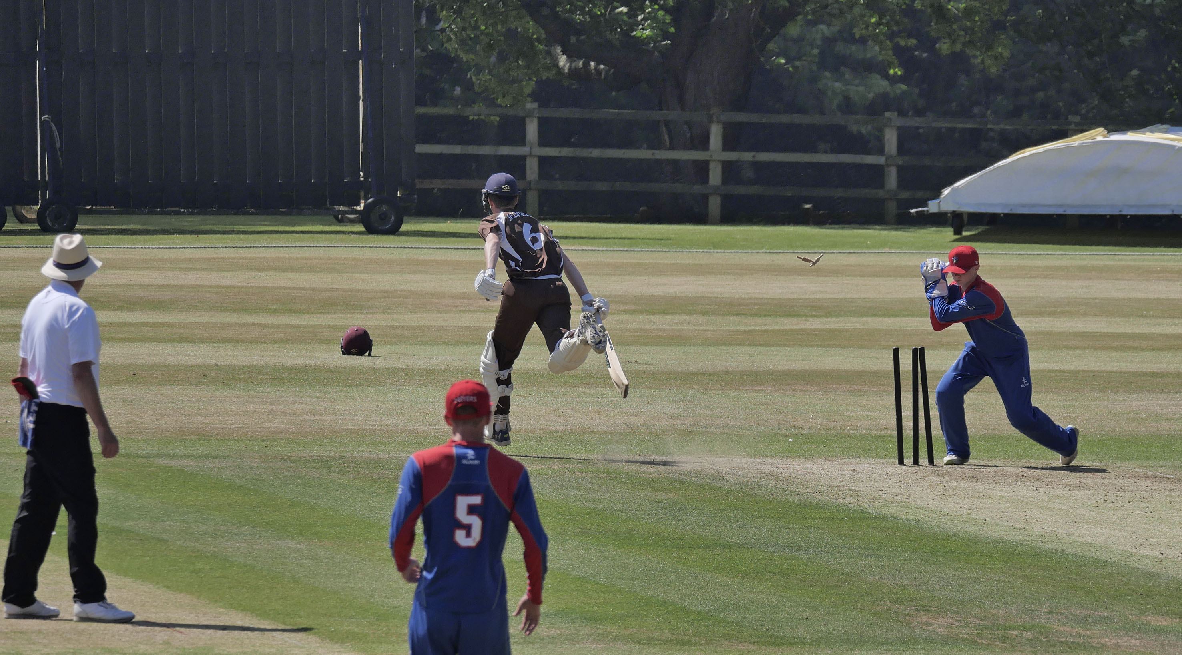
George Hill completes a run safely. Jamie Baird is the wicket-keeper.

Slide 10
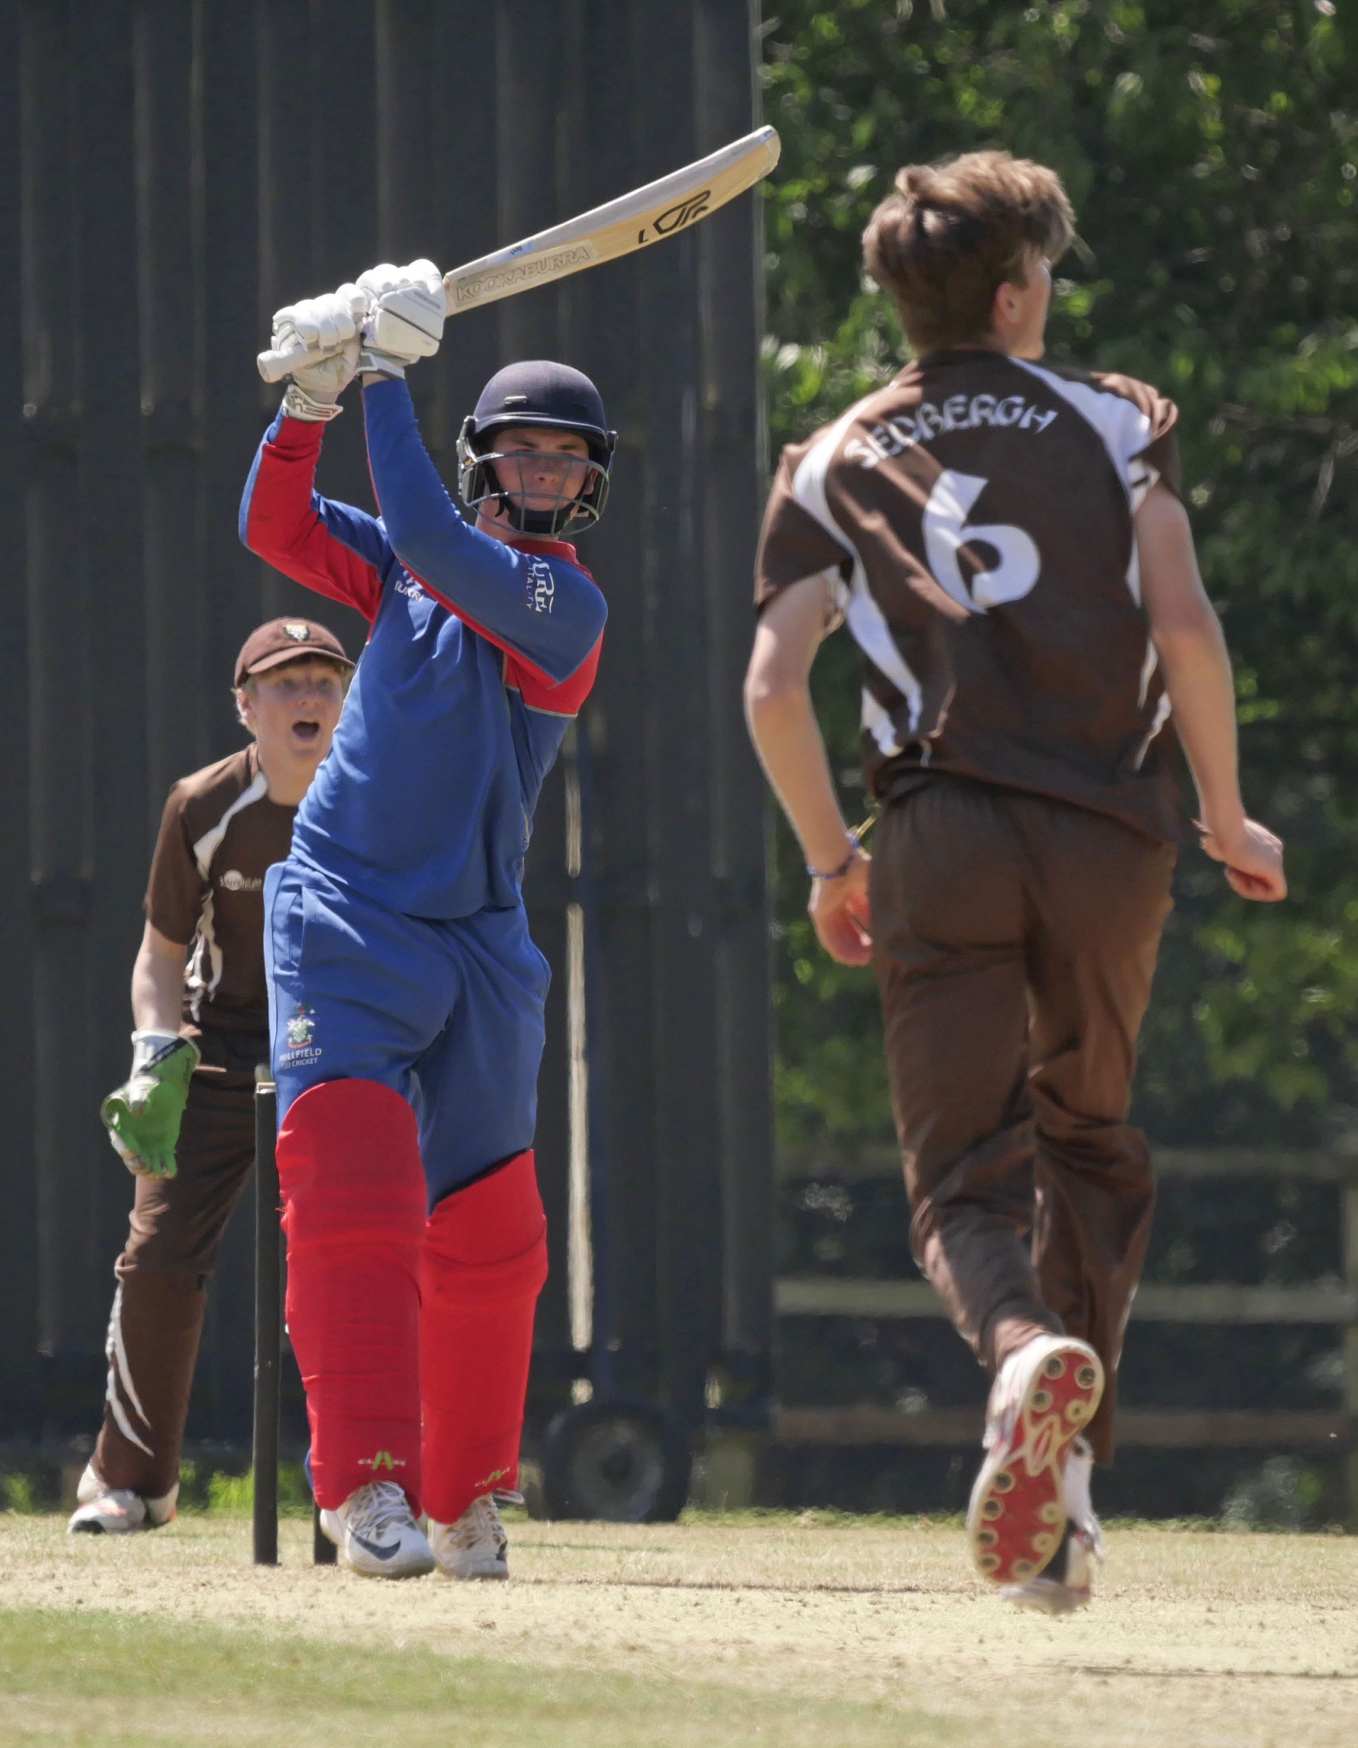
Charles Clist drives George Hill for 4

Slide 11
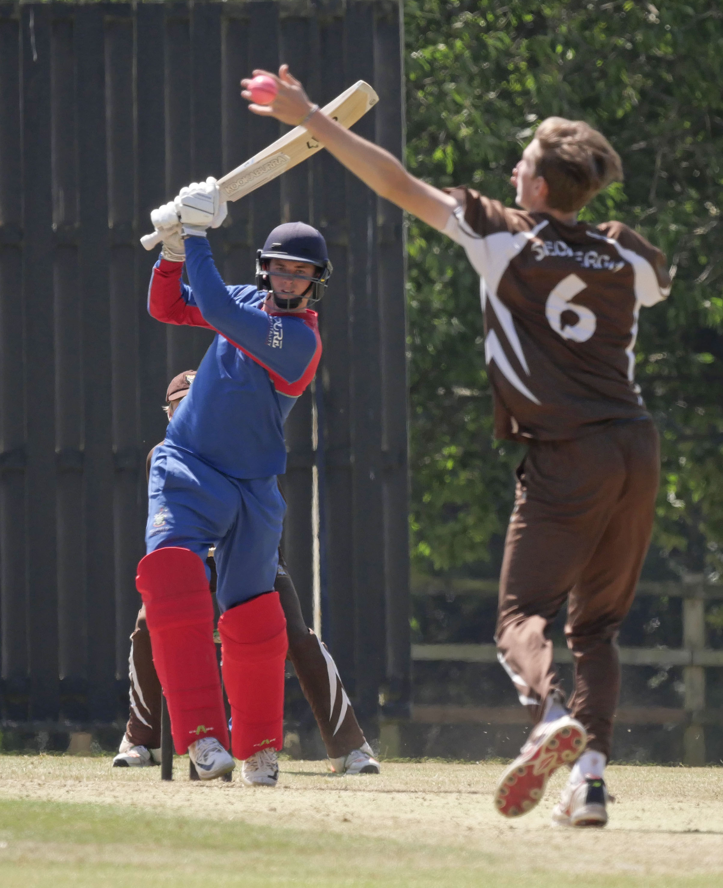
George Hill attempts to stop a drive from Charles Clist

Slide 12
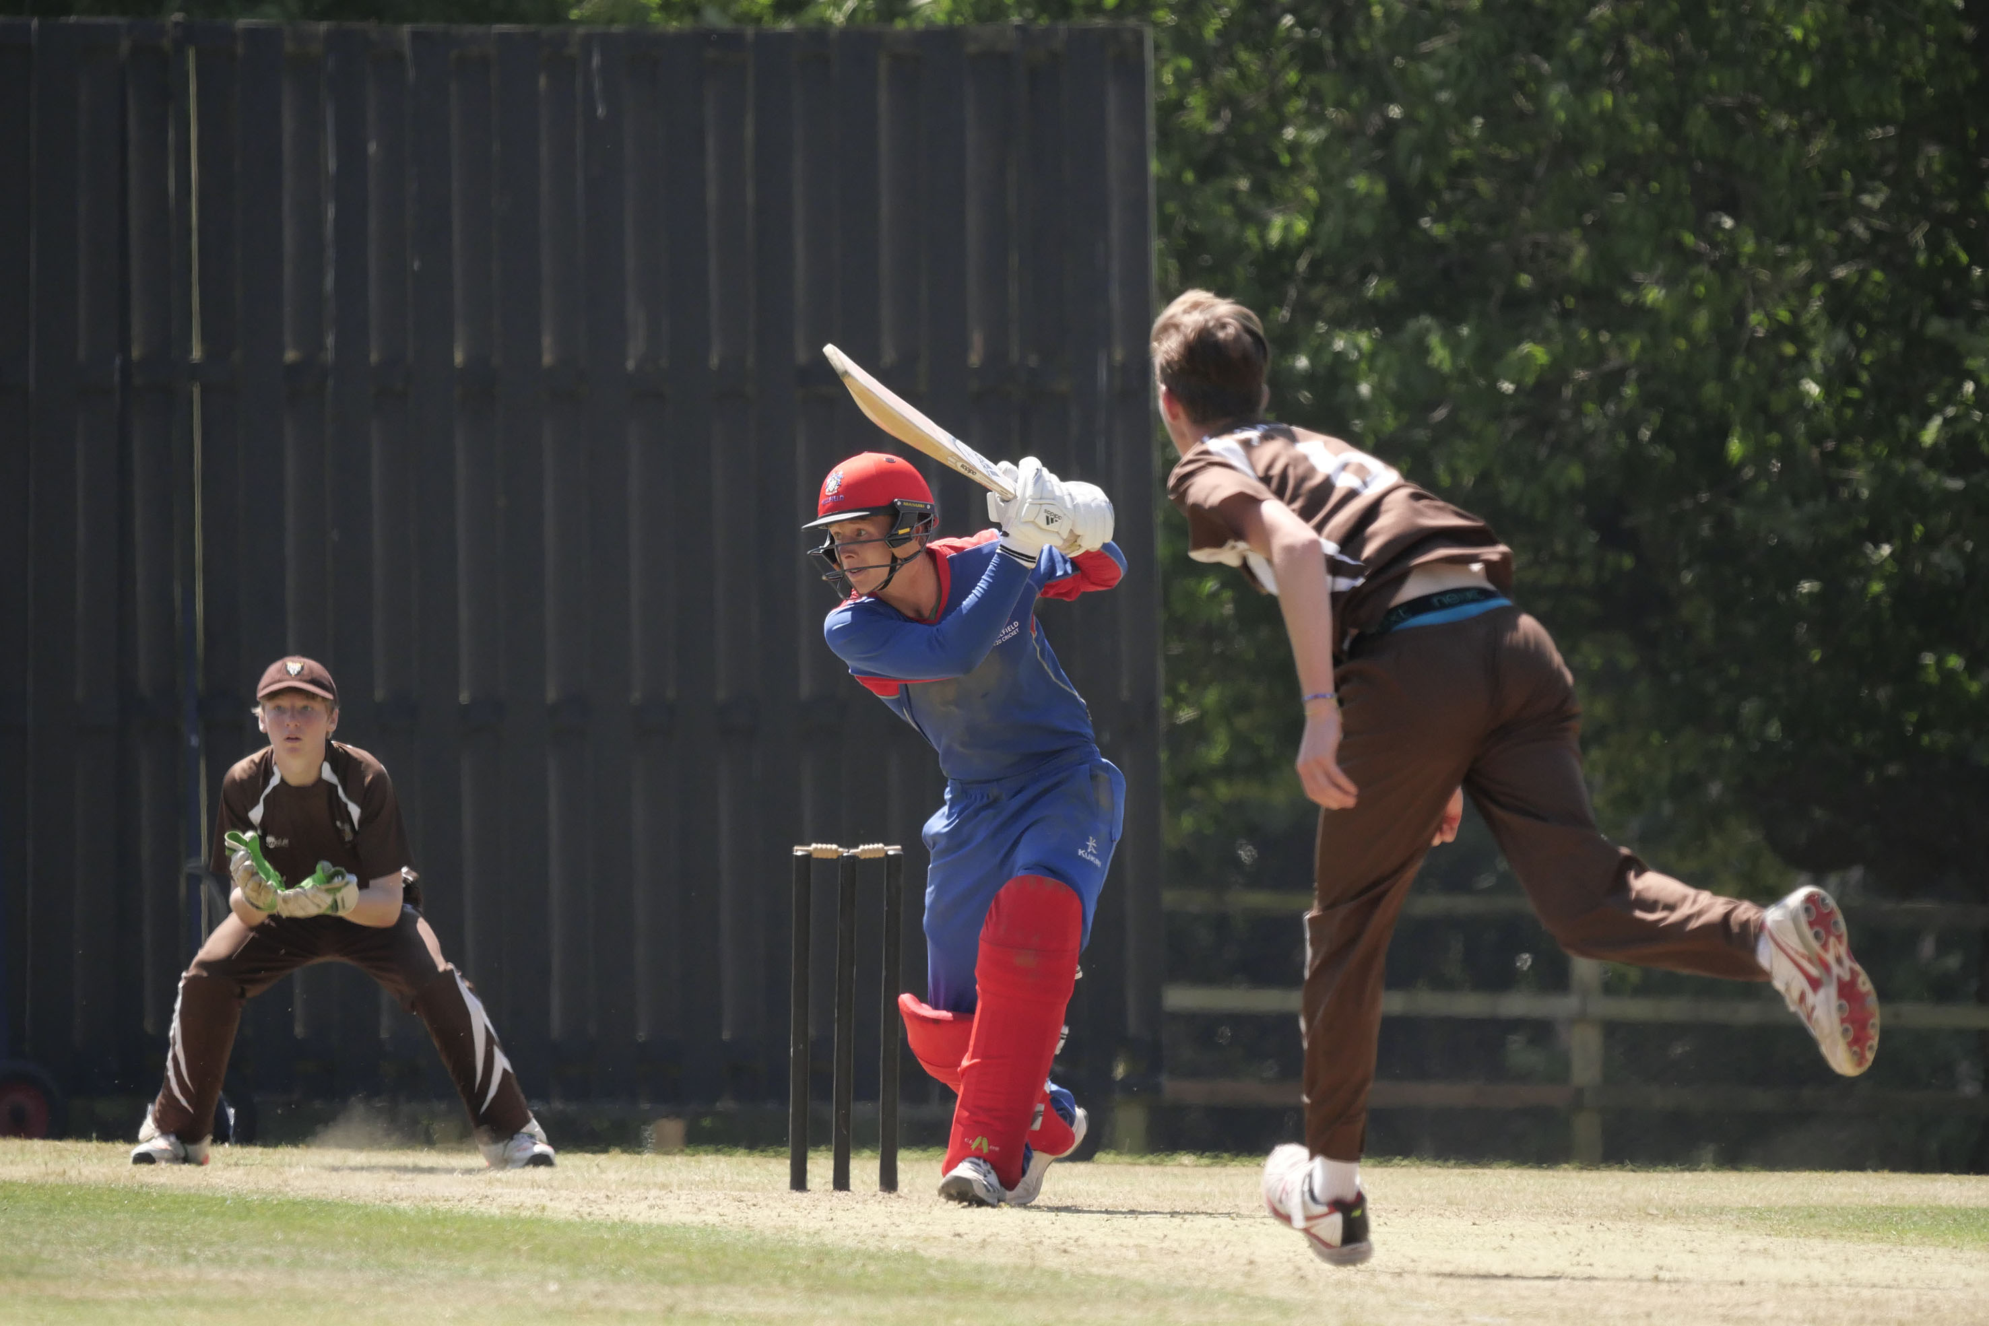
Tom Bevan drives George Hill

Slide 13
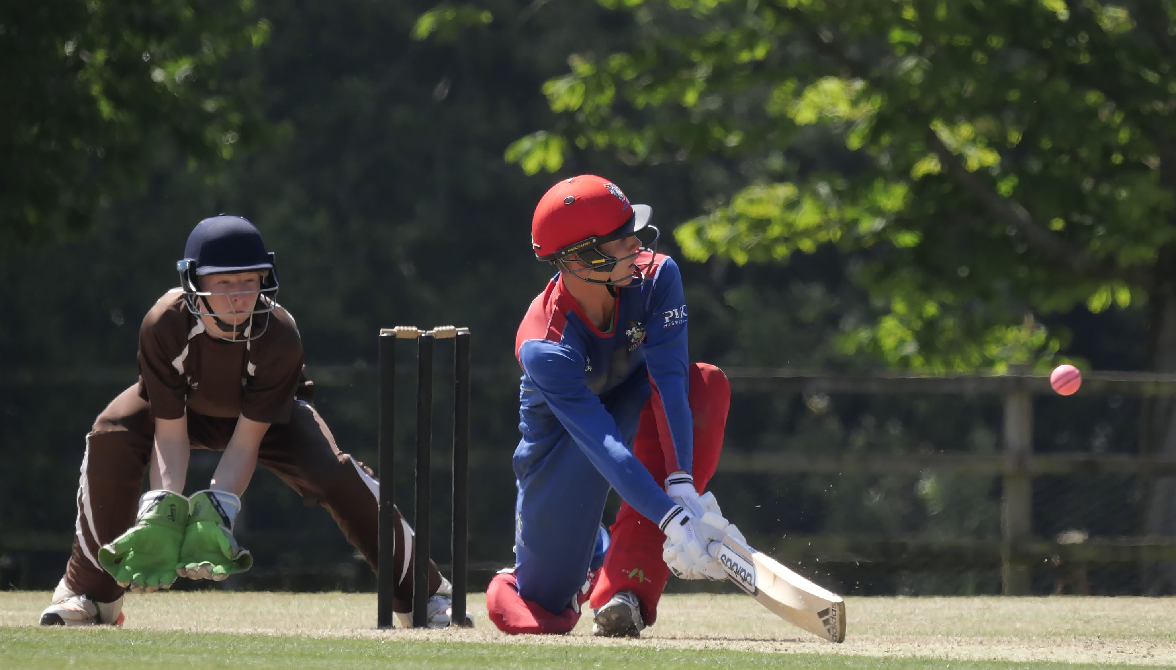
Tom Bevan sweeps Cameron Jeffers watched by Kieran Hull.

Slide 14
The second semi-final
Bedford v Charterhouse
Bedford in blue
Charterhouse in pink

Slide 15
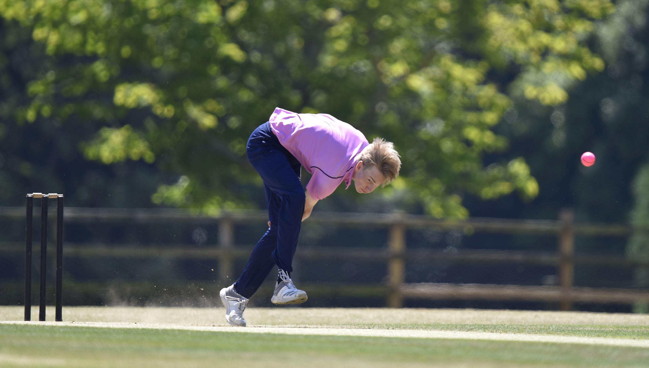
George Barlow (Charterhouse) bowling.

Slide 16
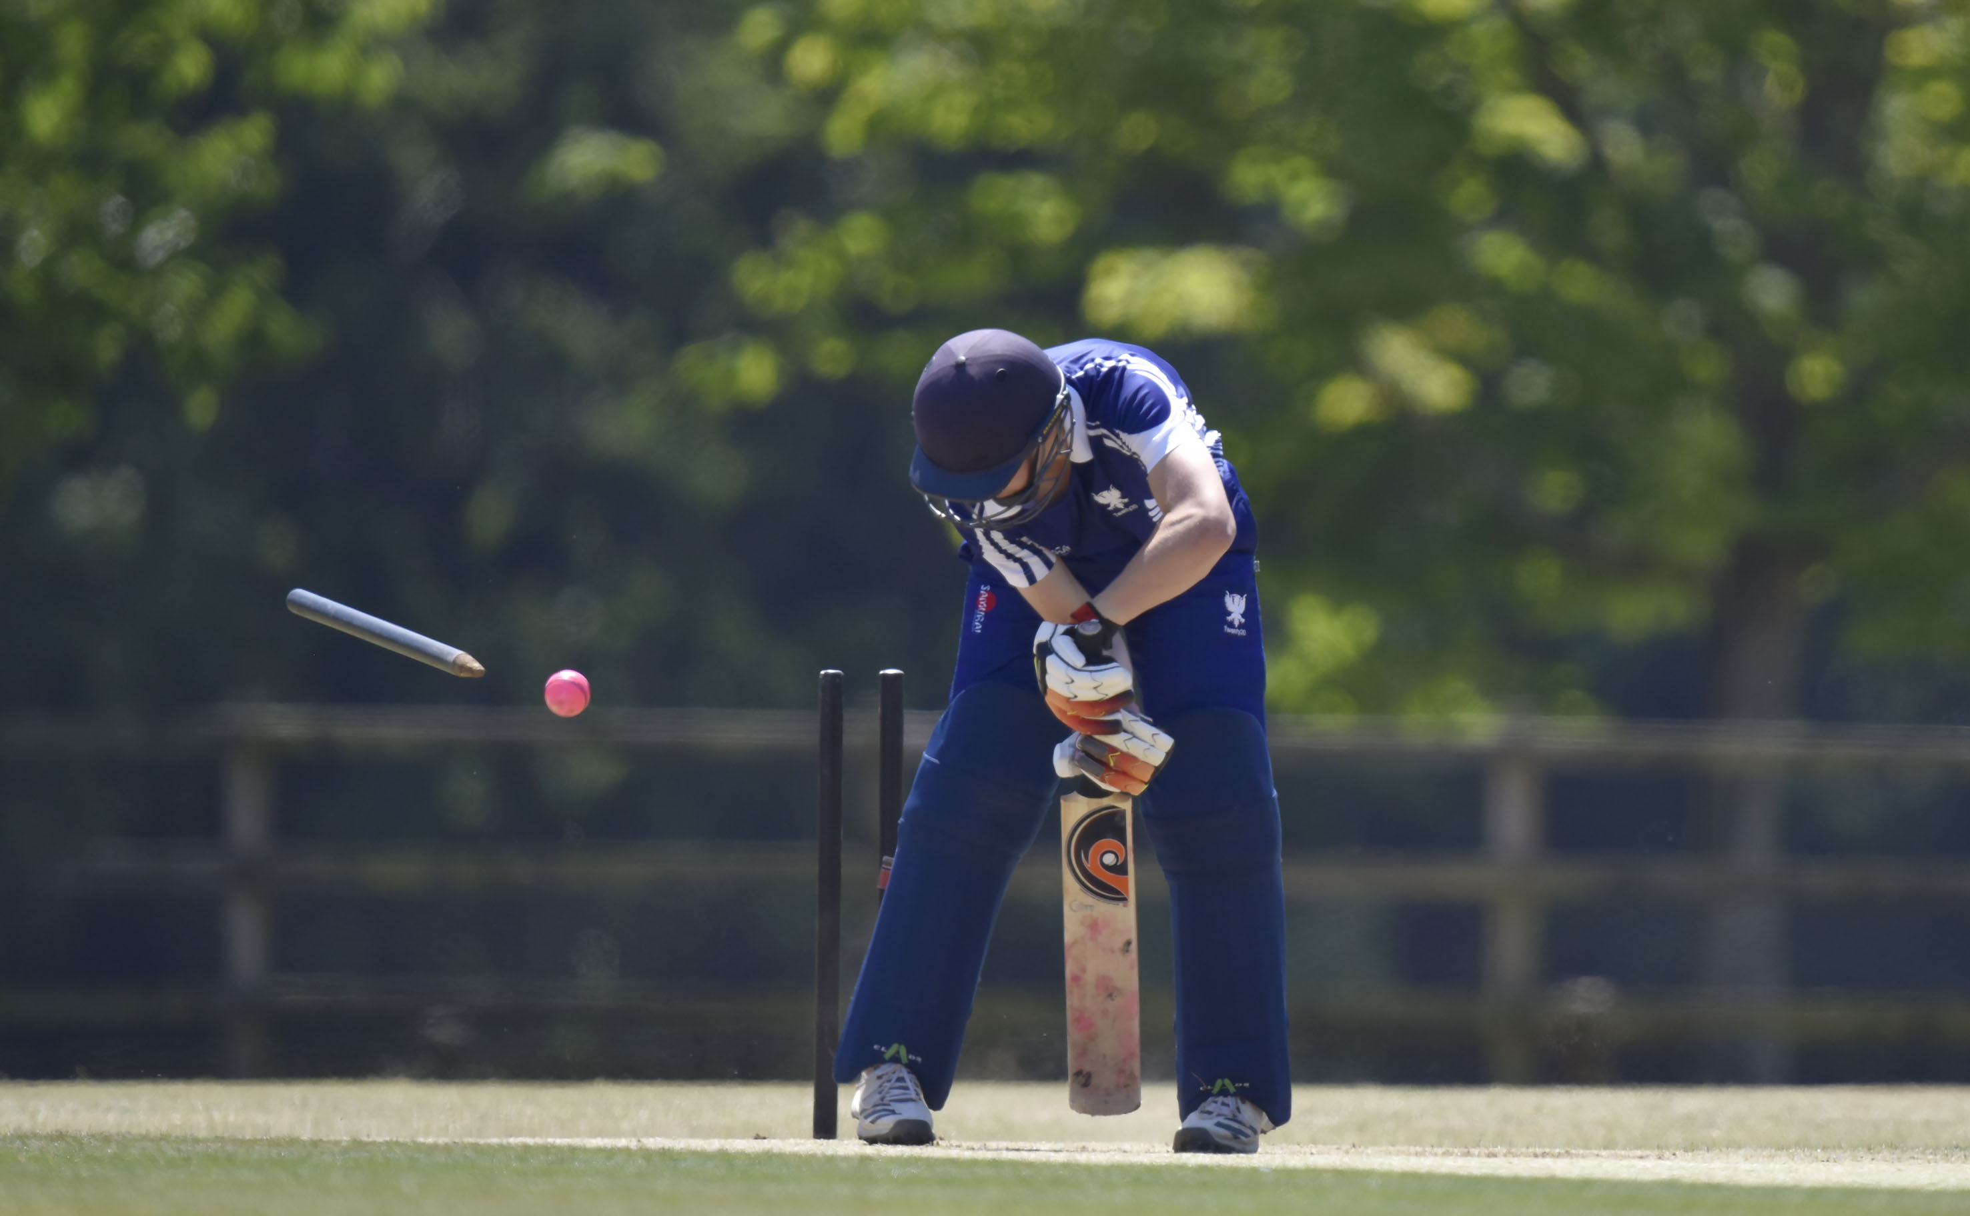
Thomas Blythman bowled by Prince Singh for 1.

Slide 17
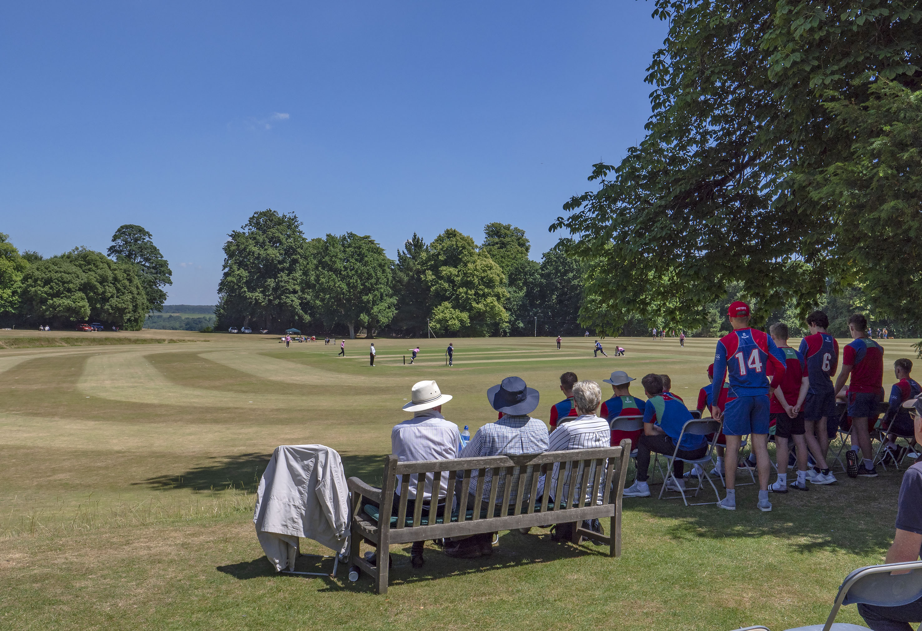
Second semi-final Charterhouse v Bedford showing a general view of the ground.

Slide 18
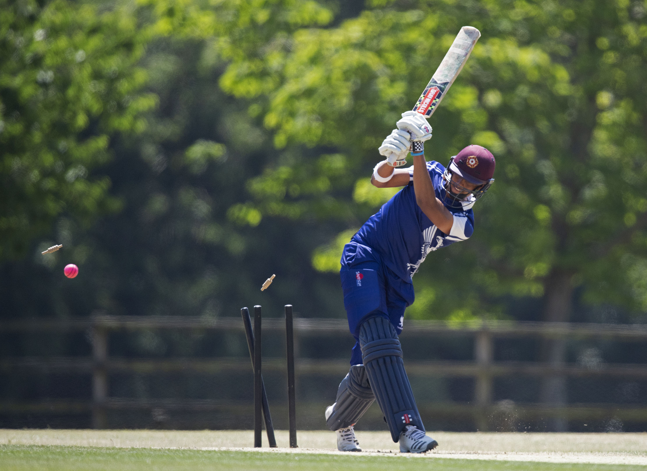
Emilio Gay bowled by Prince Singh for 2

Slide 19
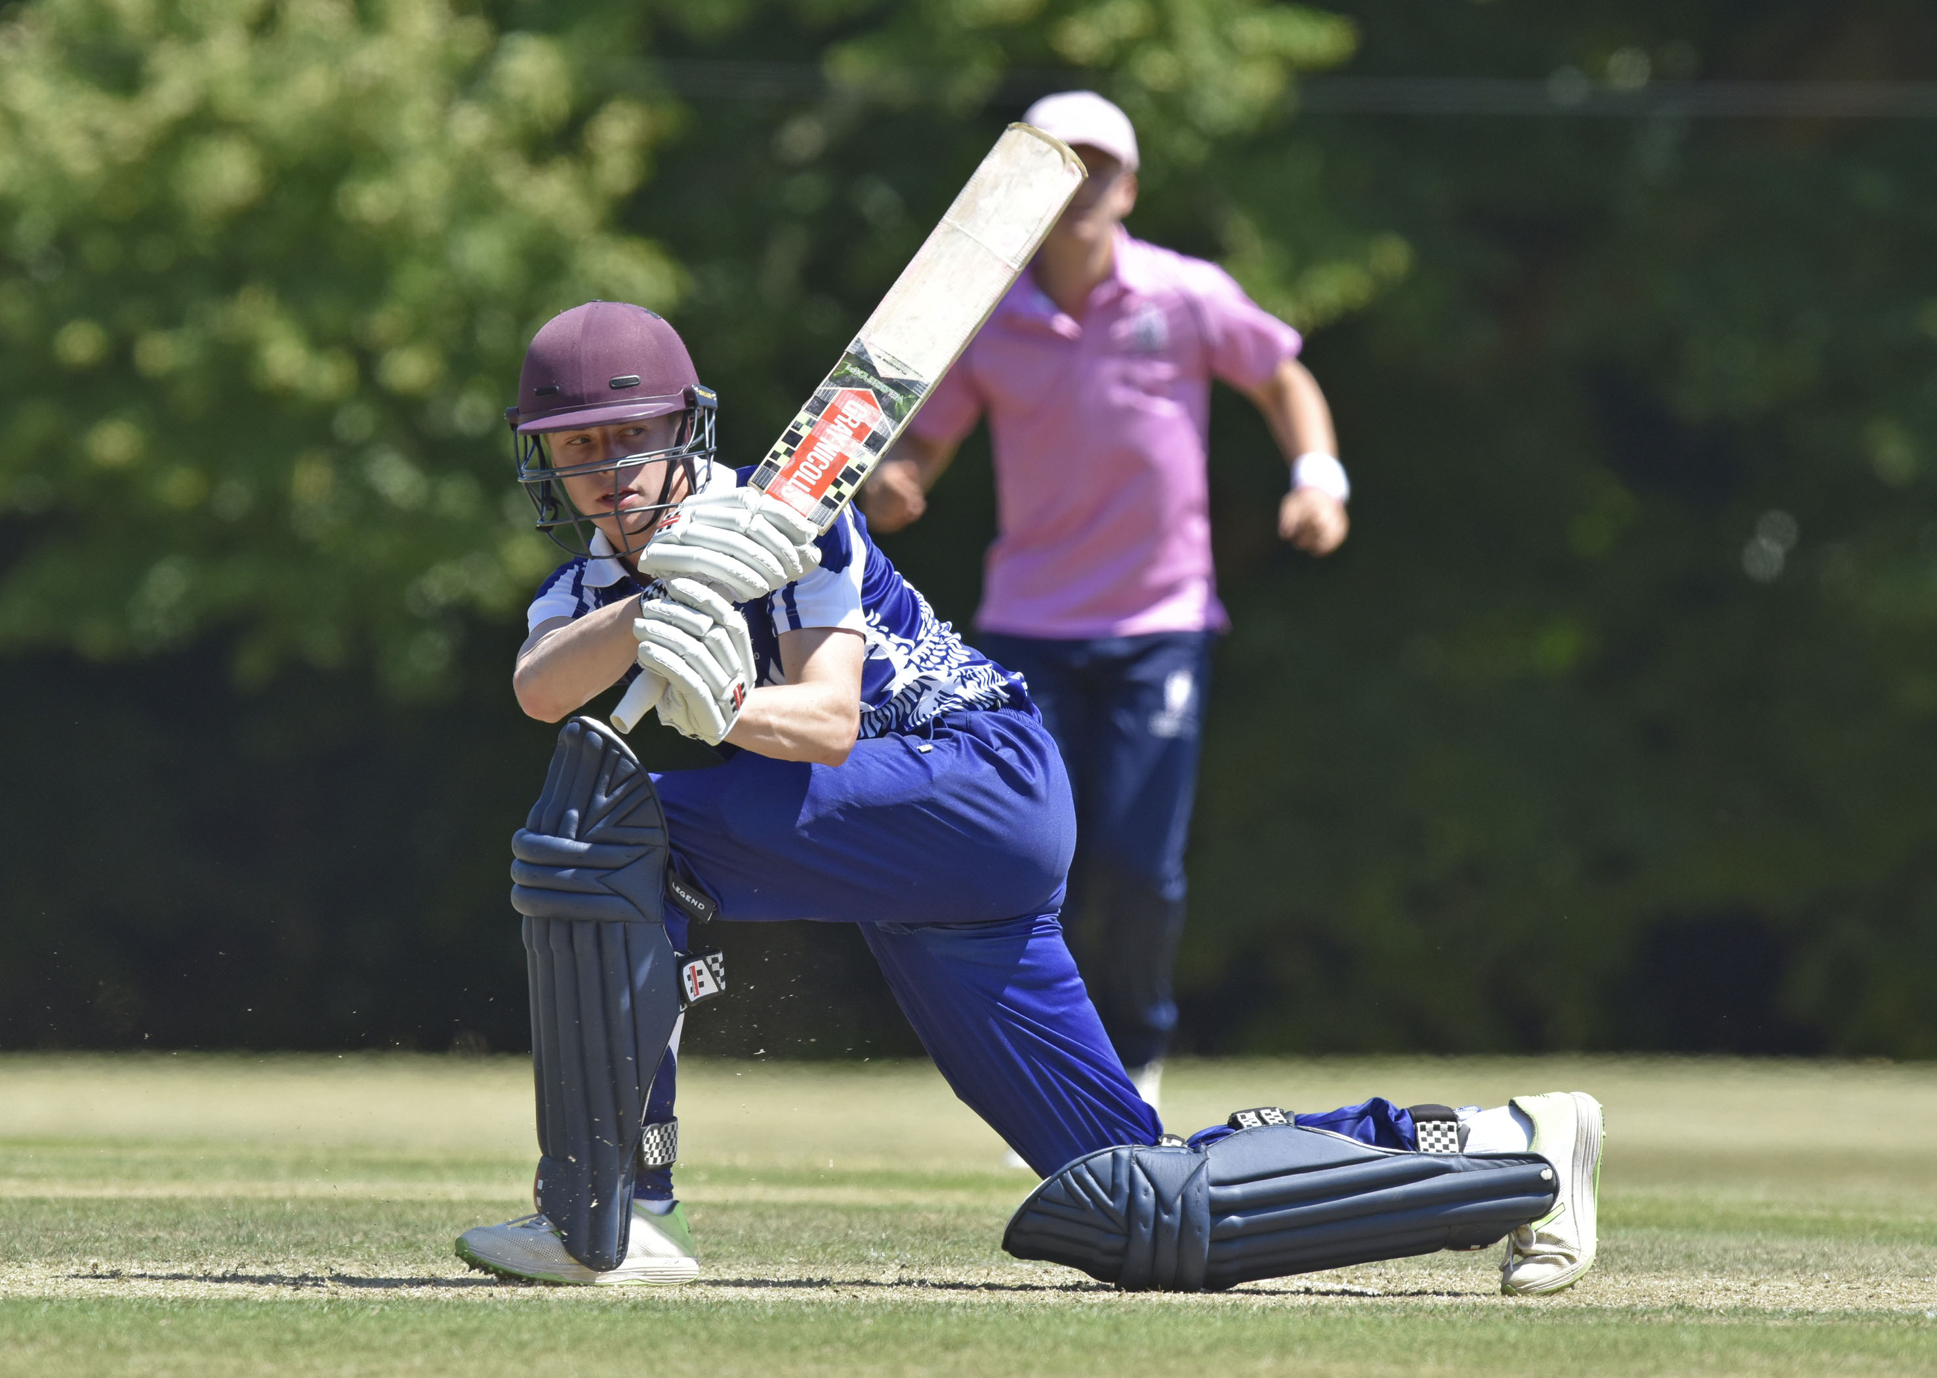
Harry Gouldstone hits to leg during his innings of 61

Slide 20
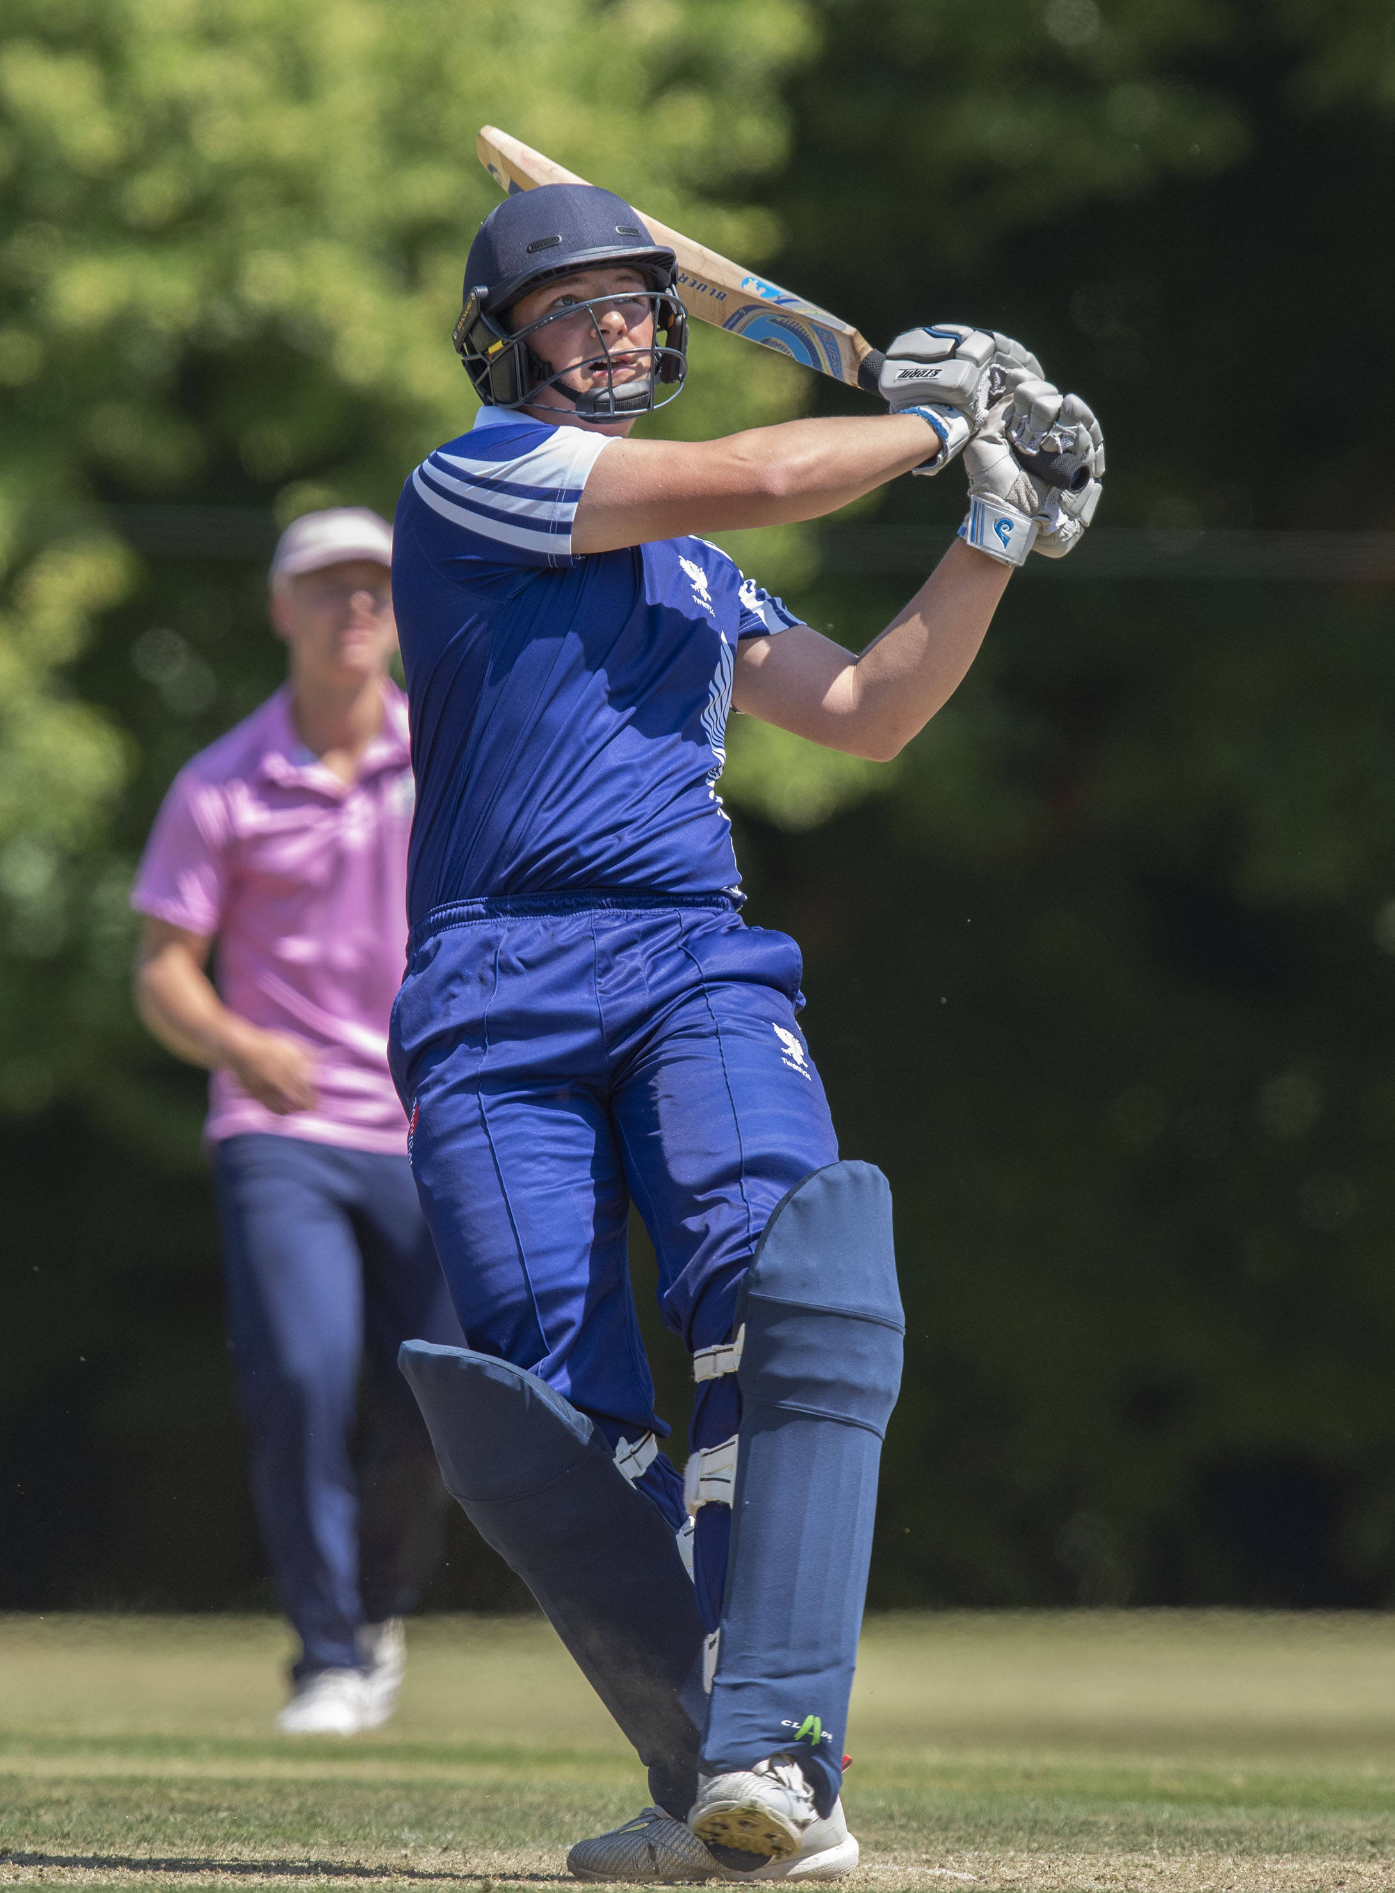
Michael Wells hits a six

Slide 21
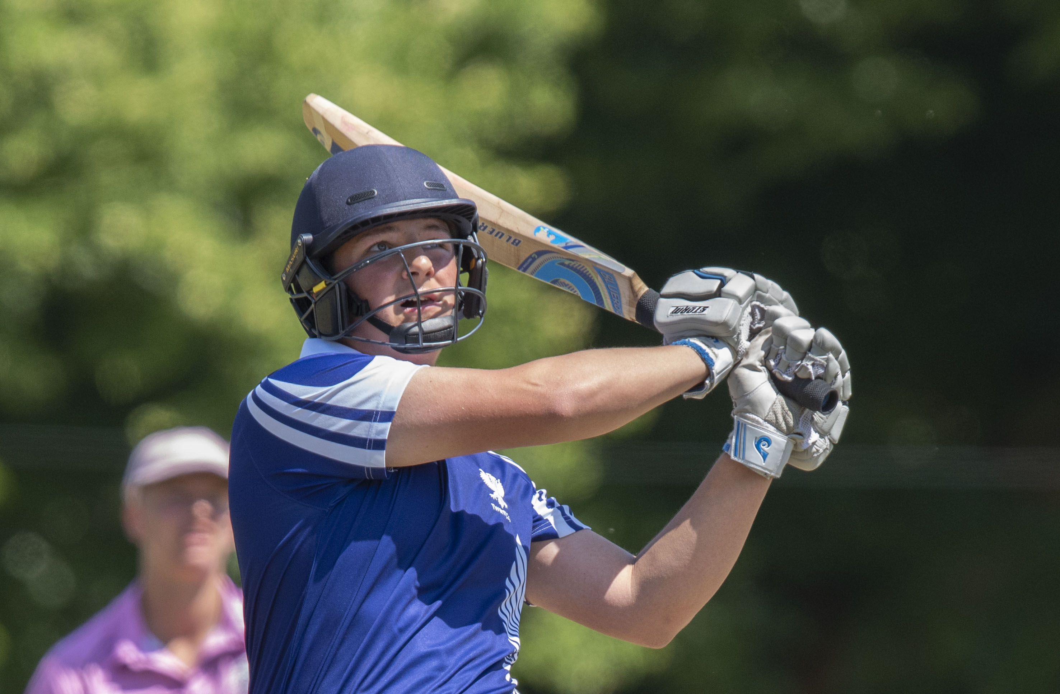
Michael Wells hits a six.

Slide 22
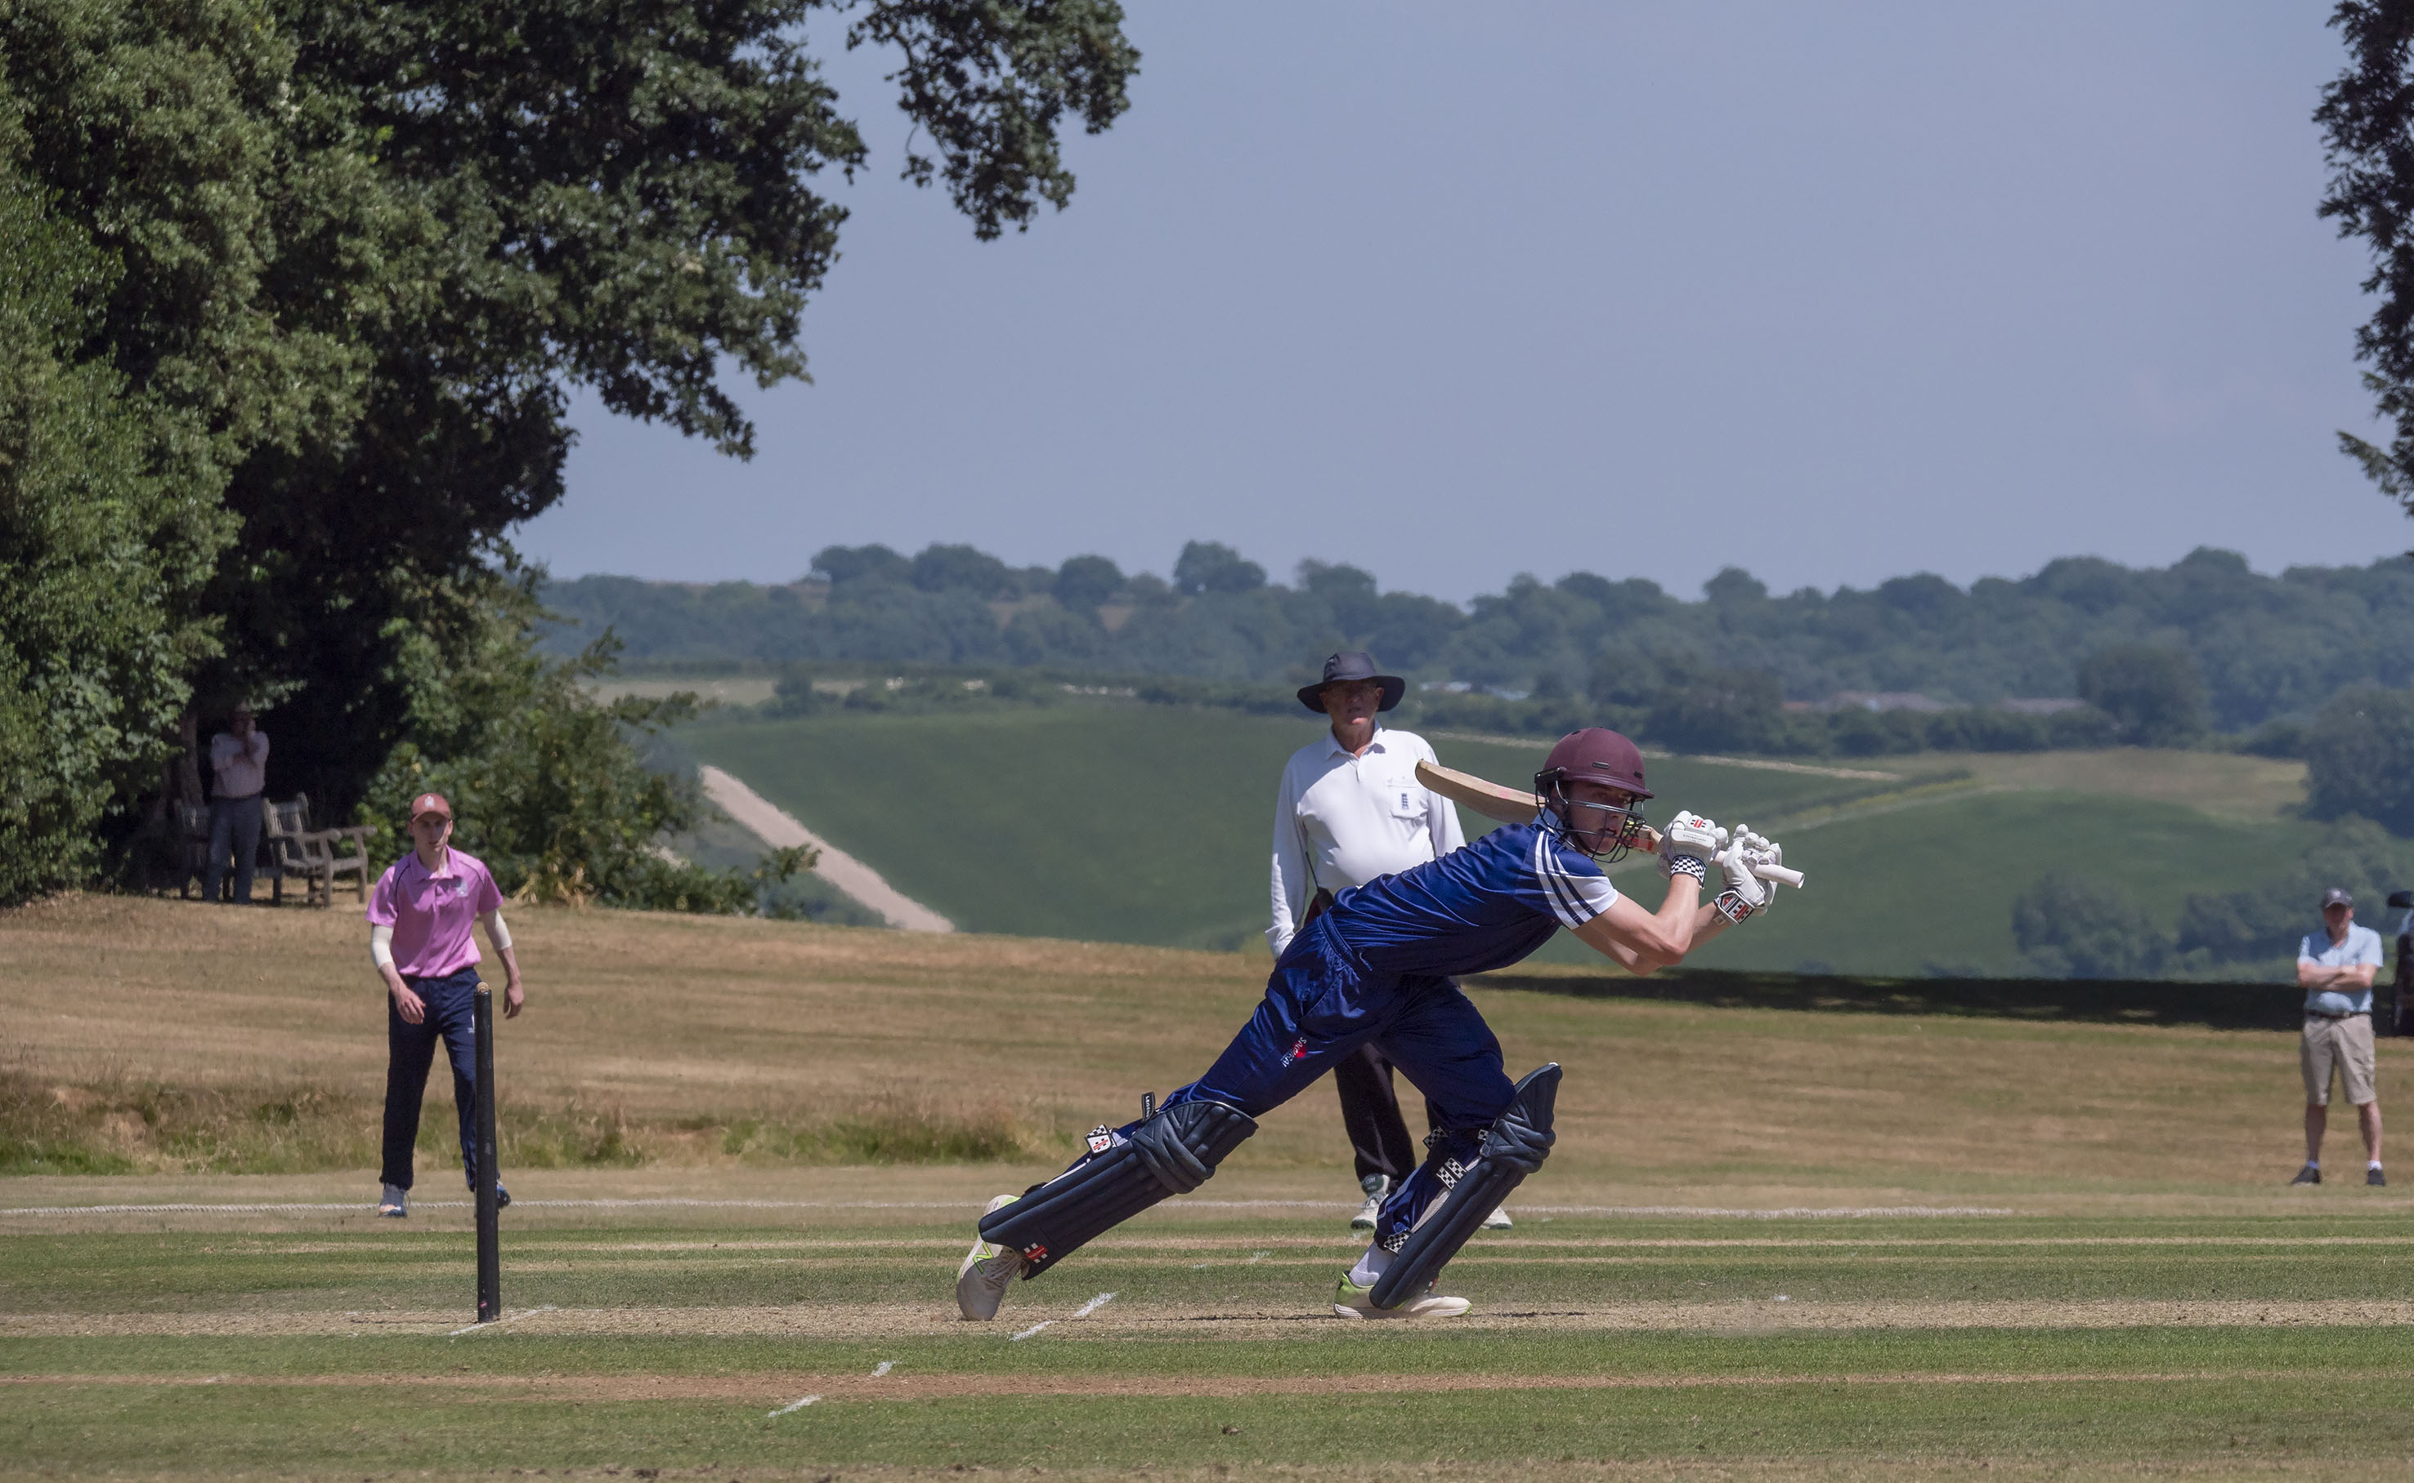
Harry Gouldstone batting during his 61

Slide 23
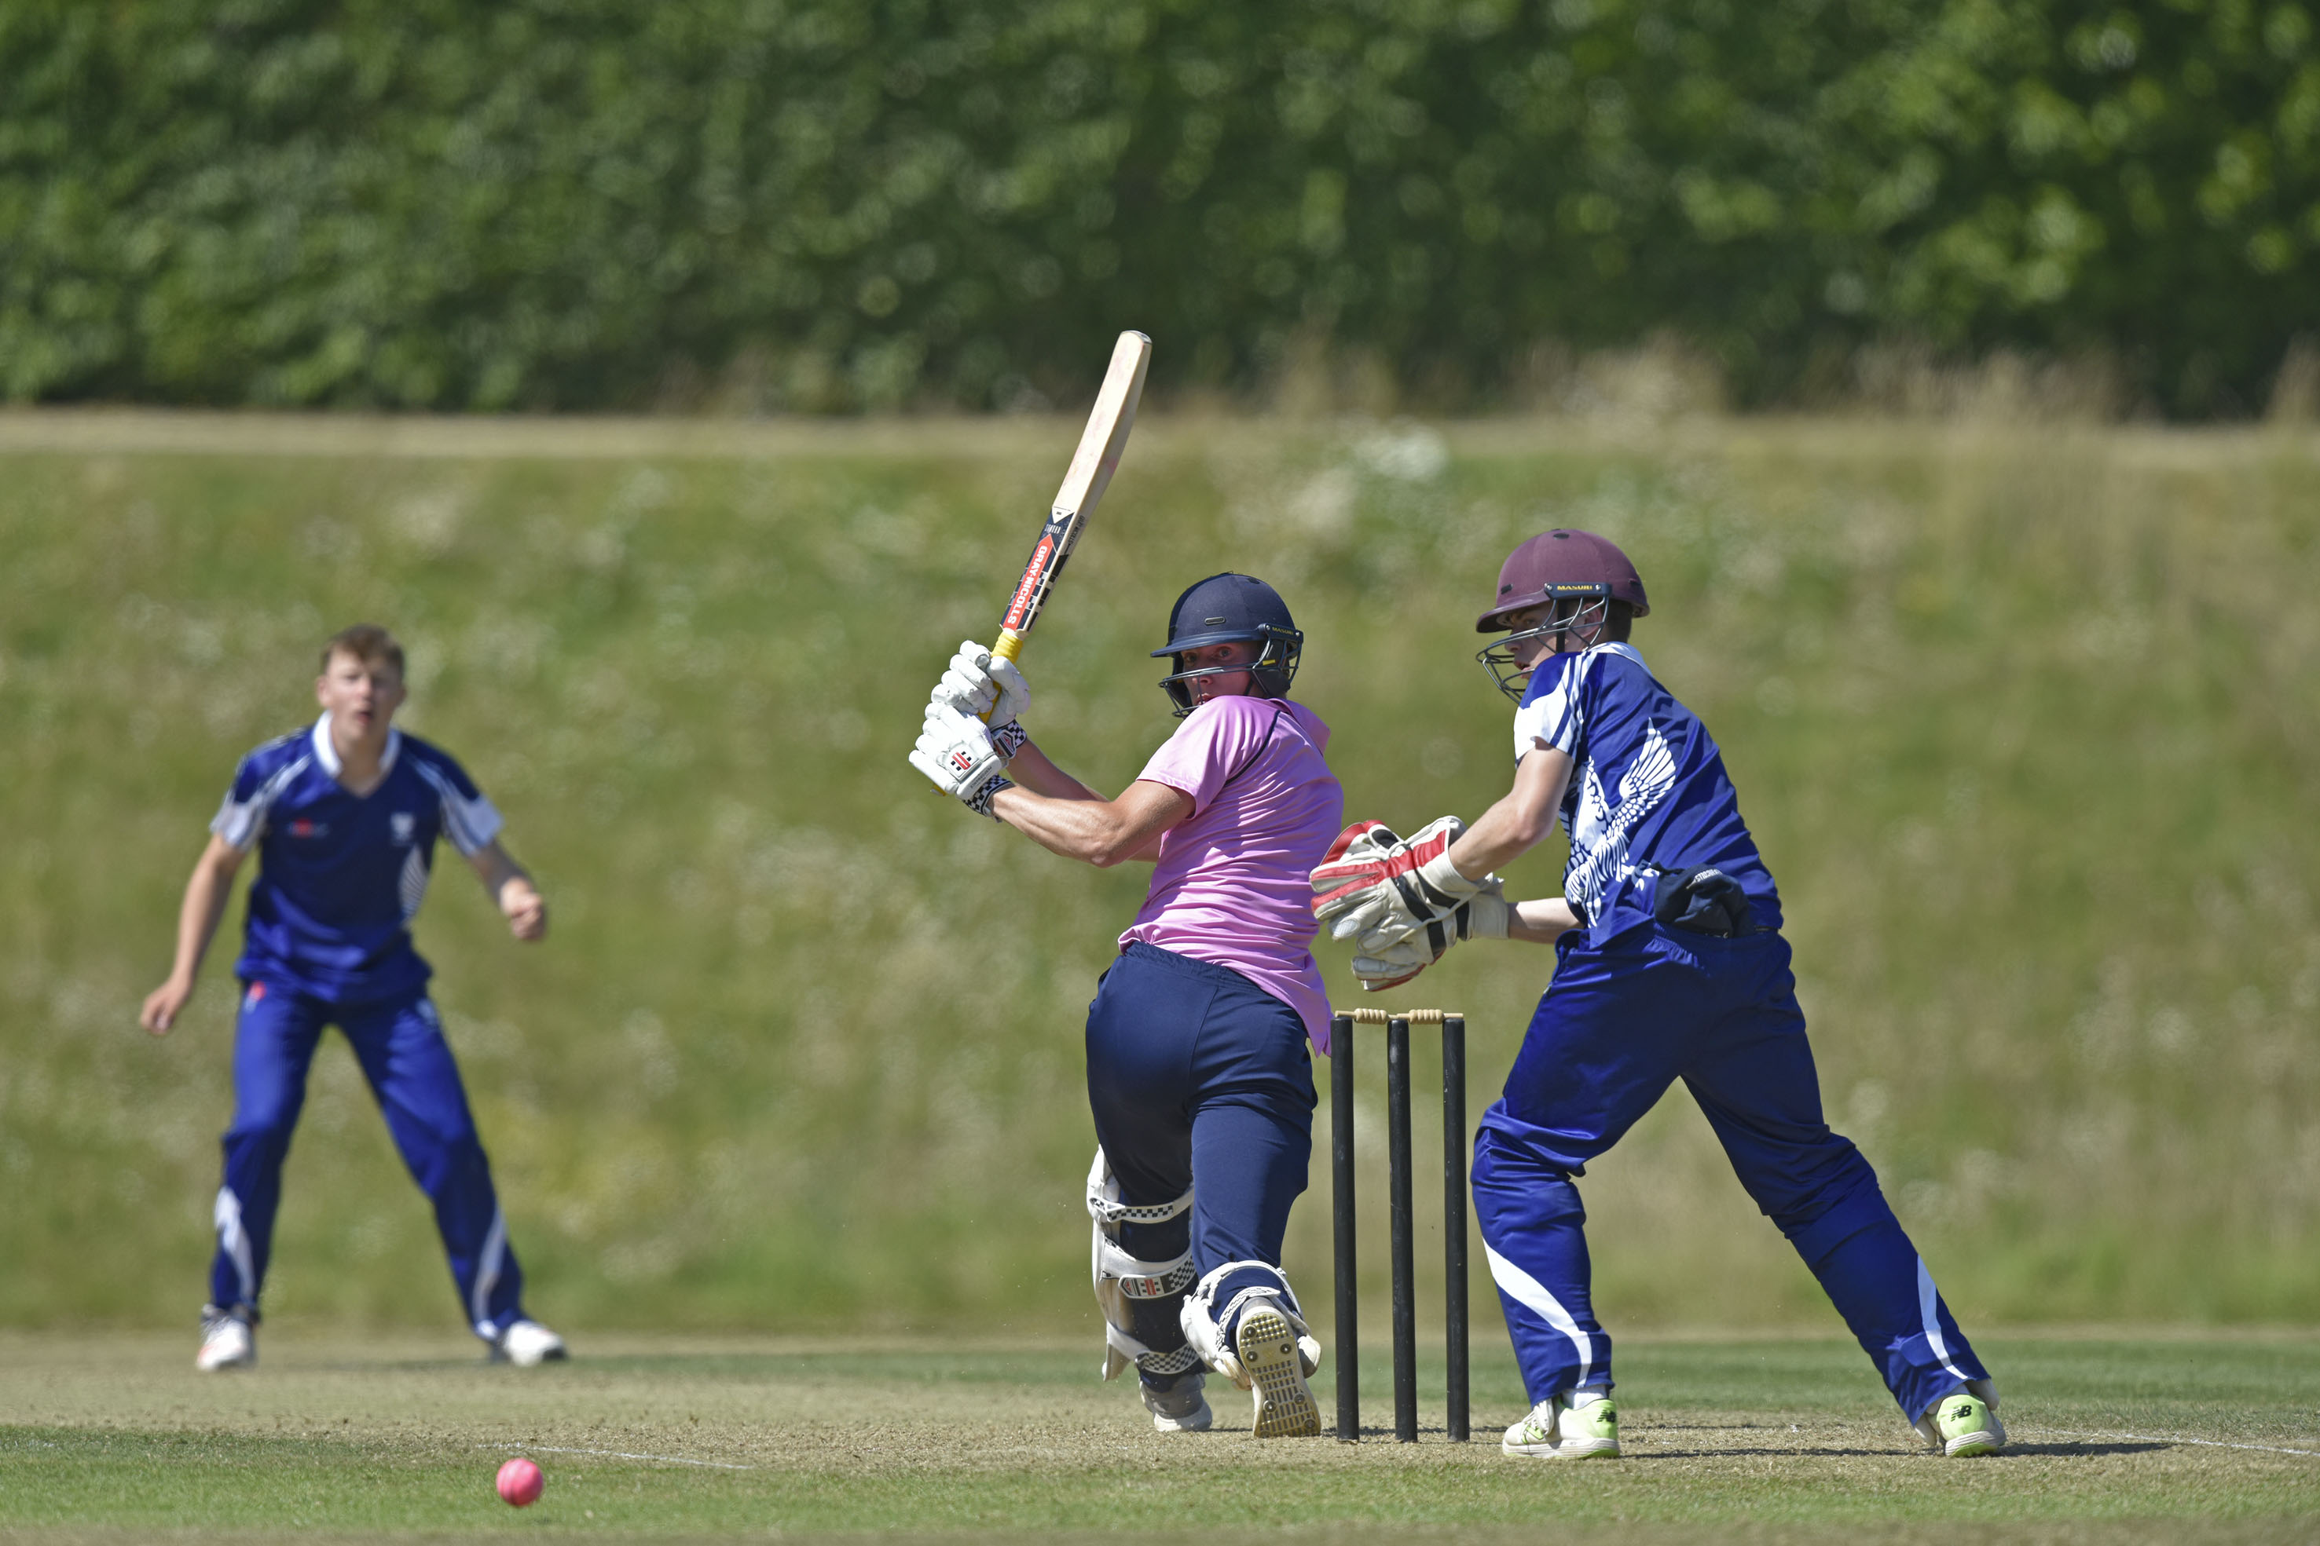
George Barlow scores a boundary during his 52

Slide 24
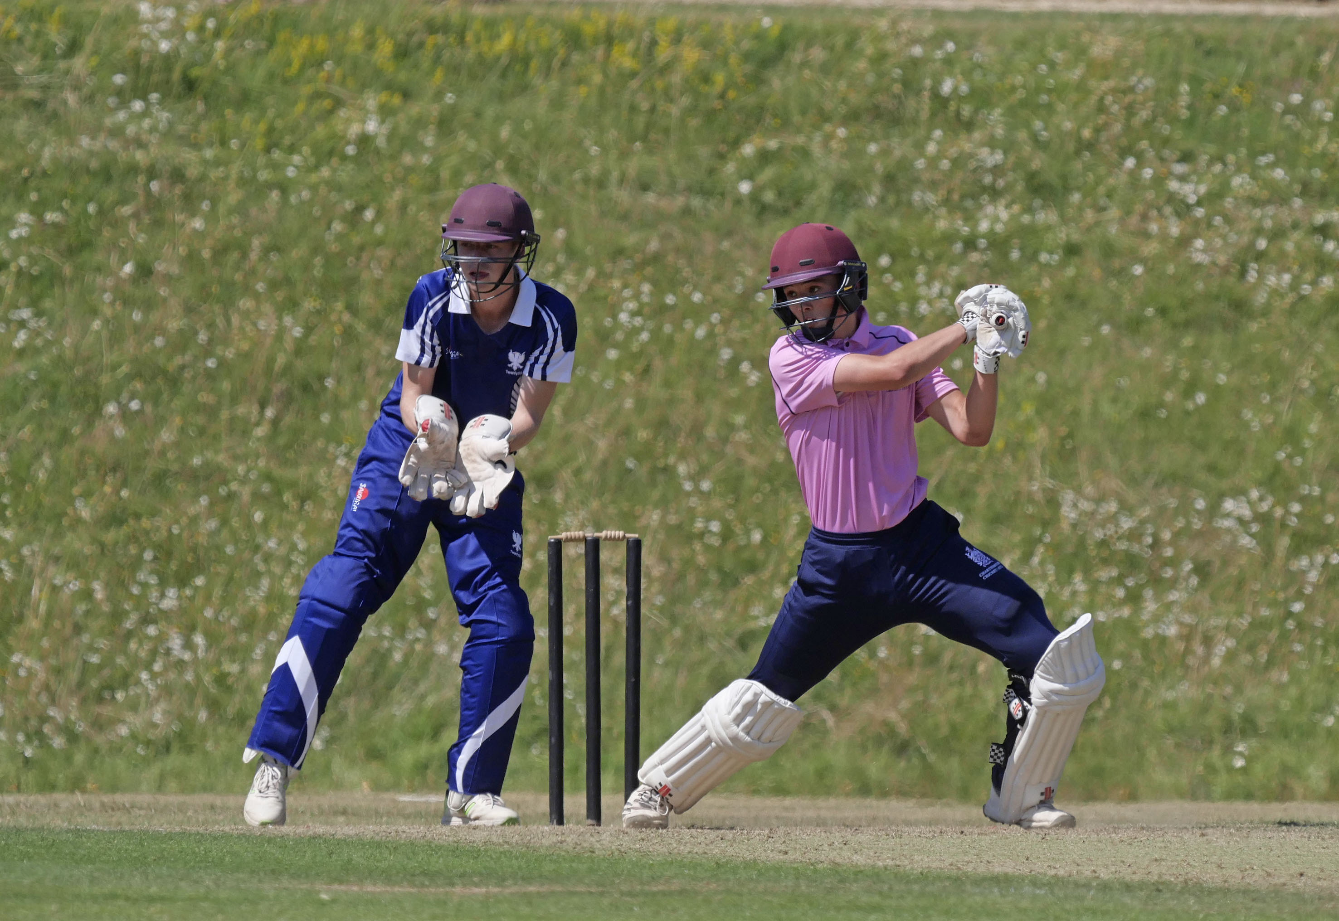
Ross Richardson batting during his 35

Slide 25
The final
Charterhouse v Millfield
Charterhouse in pink
Millfield in blue

Slide 26
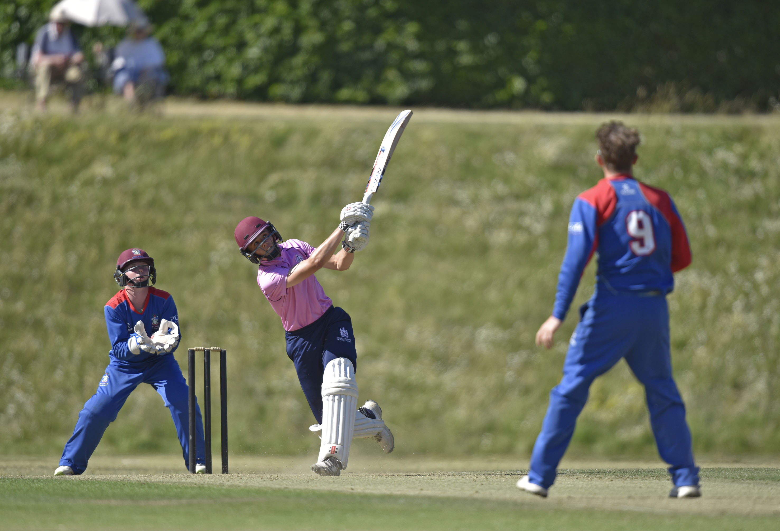
Ross Richardson playing the shot off Tom Bevan that got him caught on the boundary for 19

Slide 27
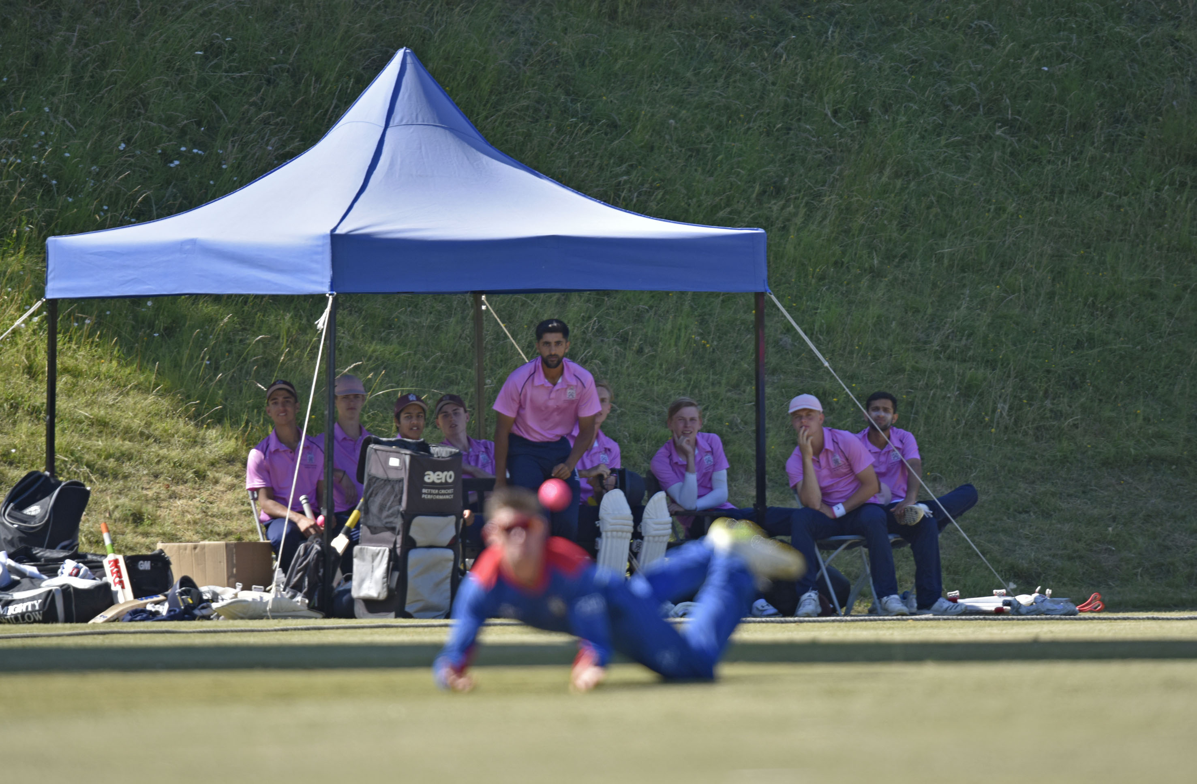
The Charterhouse team watch as Millfield drop a catch in the first over

Slide 28
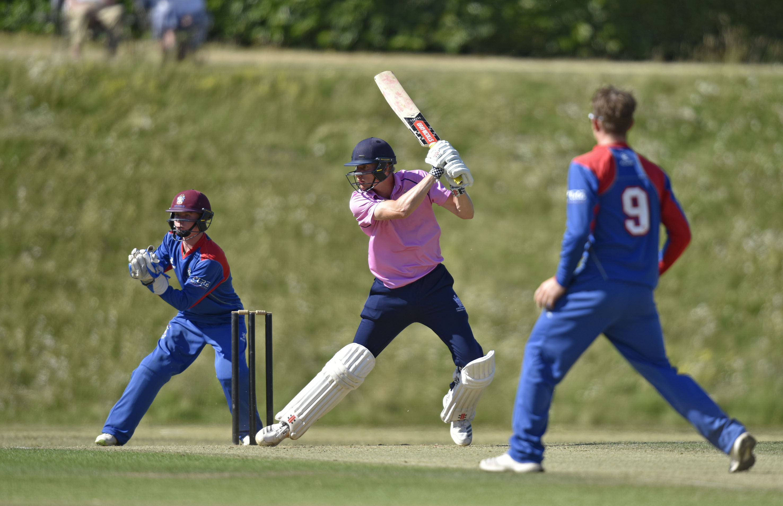
George Barlow, the Charterhouse captain, hits Thomas Bevan, the Millfield captain, through the covers during his 48

Slide 29
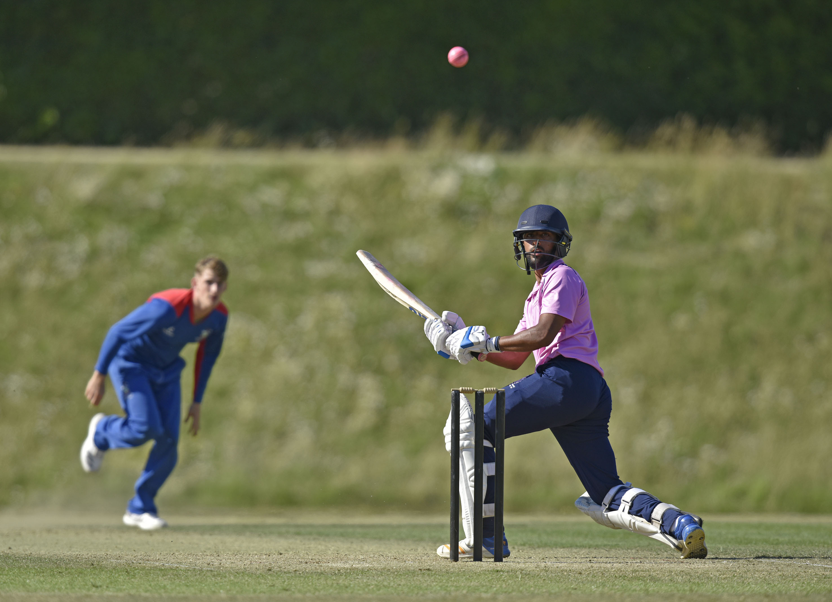
Prince Singh hits Easterfield for 4

Slide 30
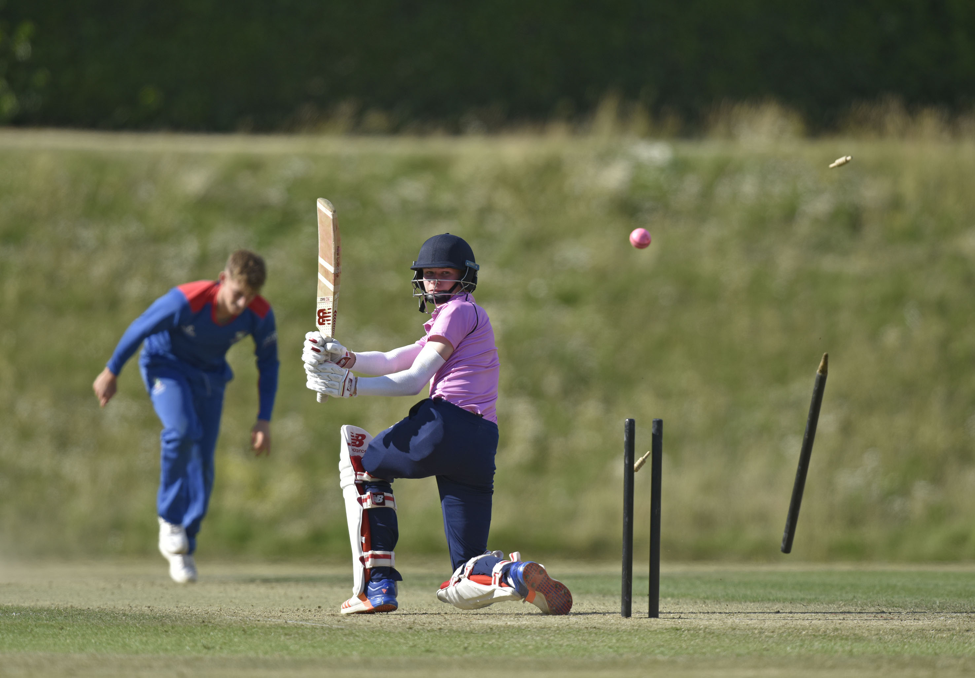
Toby Rawlings is bowled by William Easterfield.

Slide 31
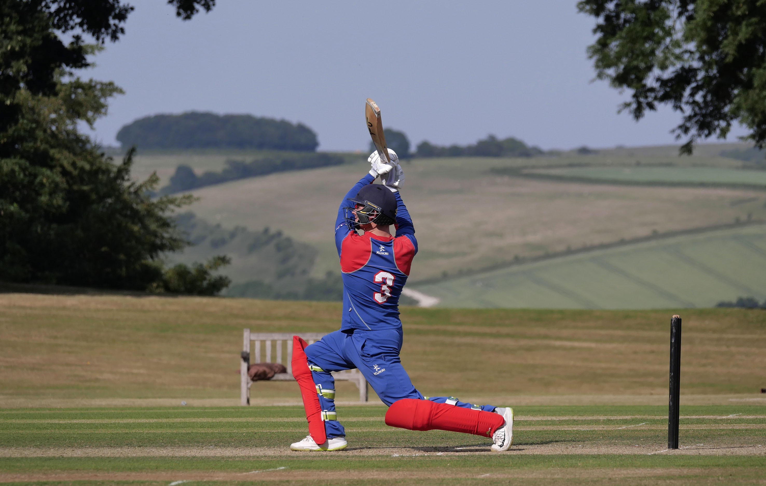
Clist hits out during his 44

Slide 32
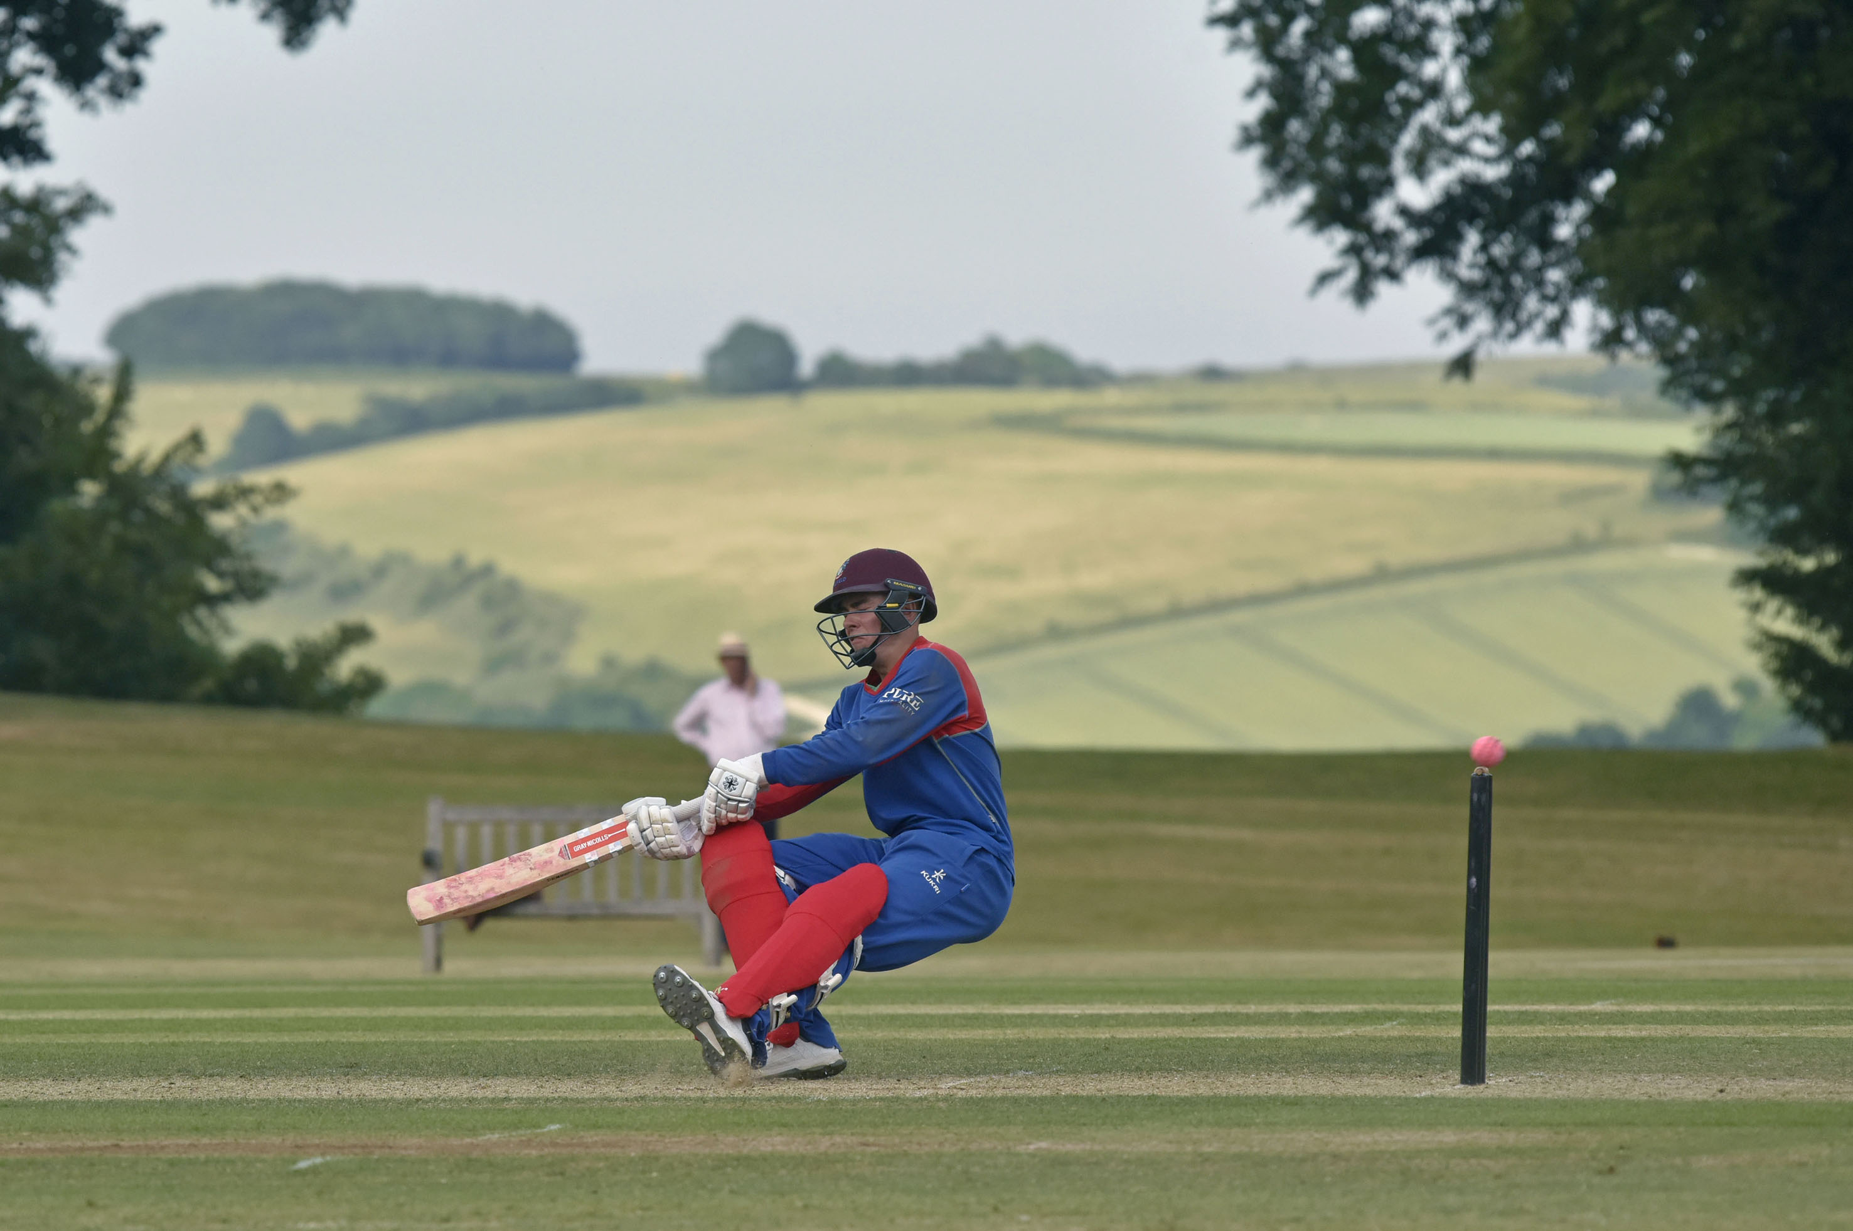
Marcus Critchley plays a paddle shot in which he falls over on his back

Slide 33
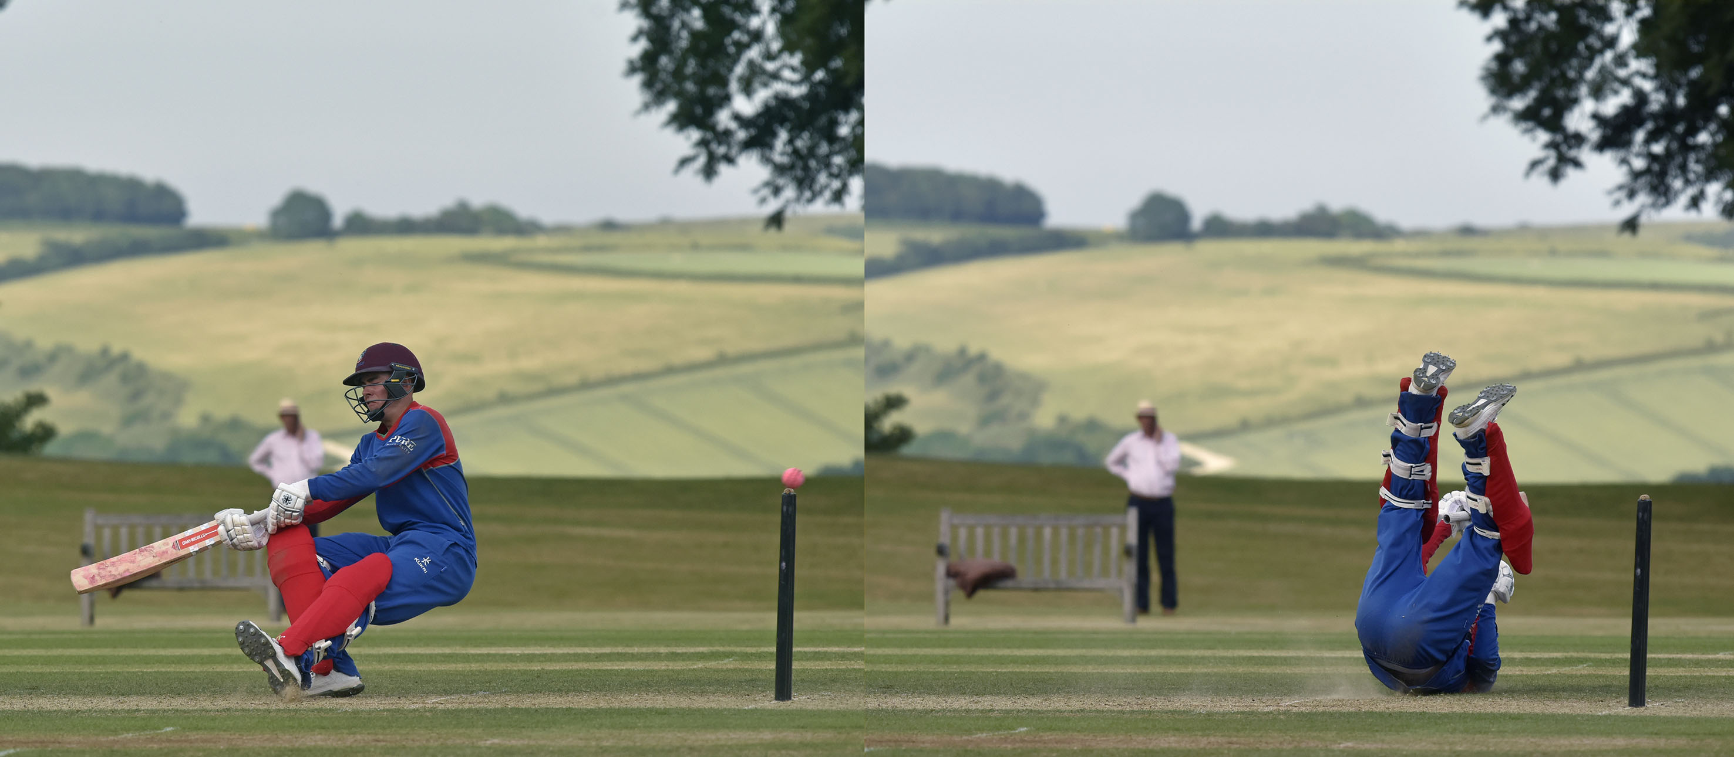
Marcus Critchley plays a paddle shot in which he falls over on his back

Slide 34
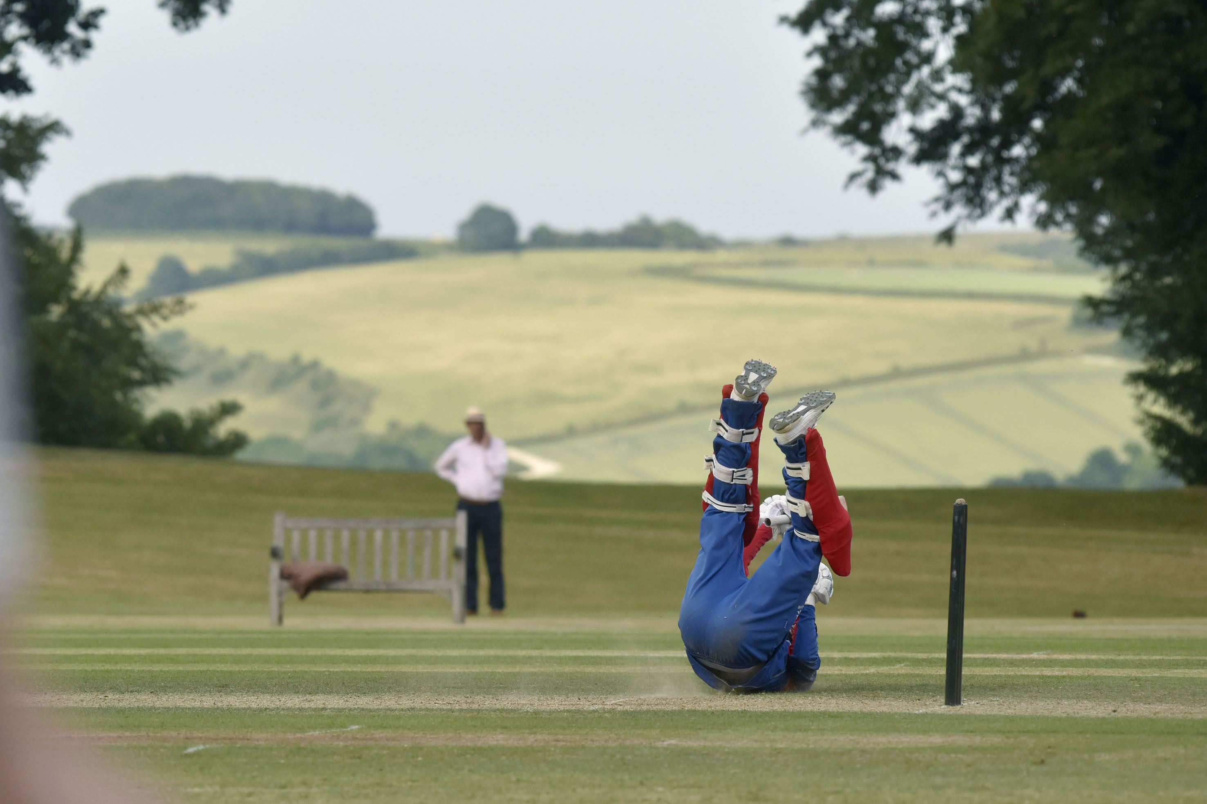
Marcus Critchley plays a paddle shot in which he falls over on his back

Slide 35
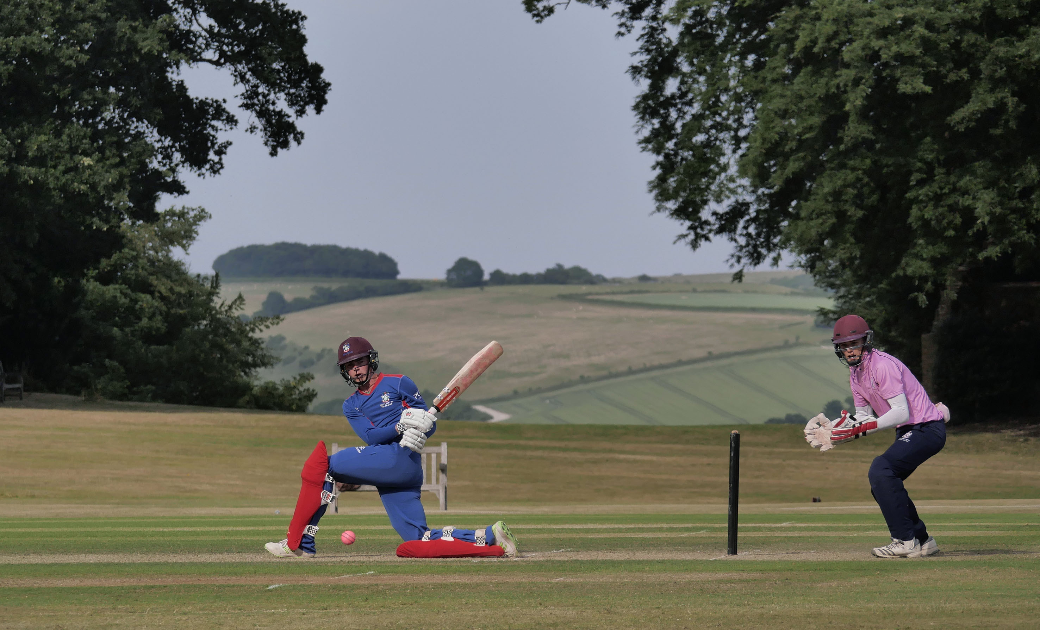
Opener Sam Young (29) sweeps watched by Ross Richardson

Slide 36
Charles Clist hits out during his 44

Slide 37
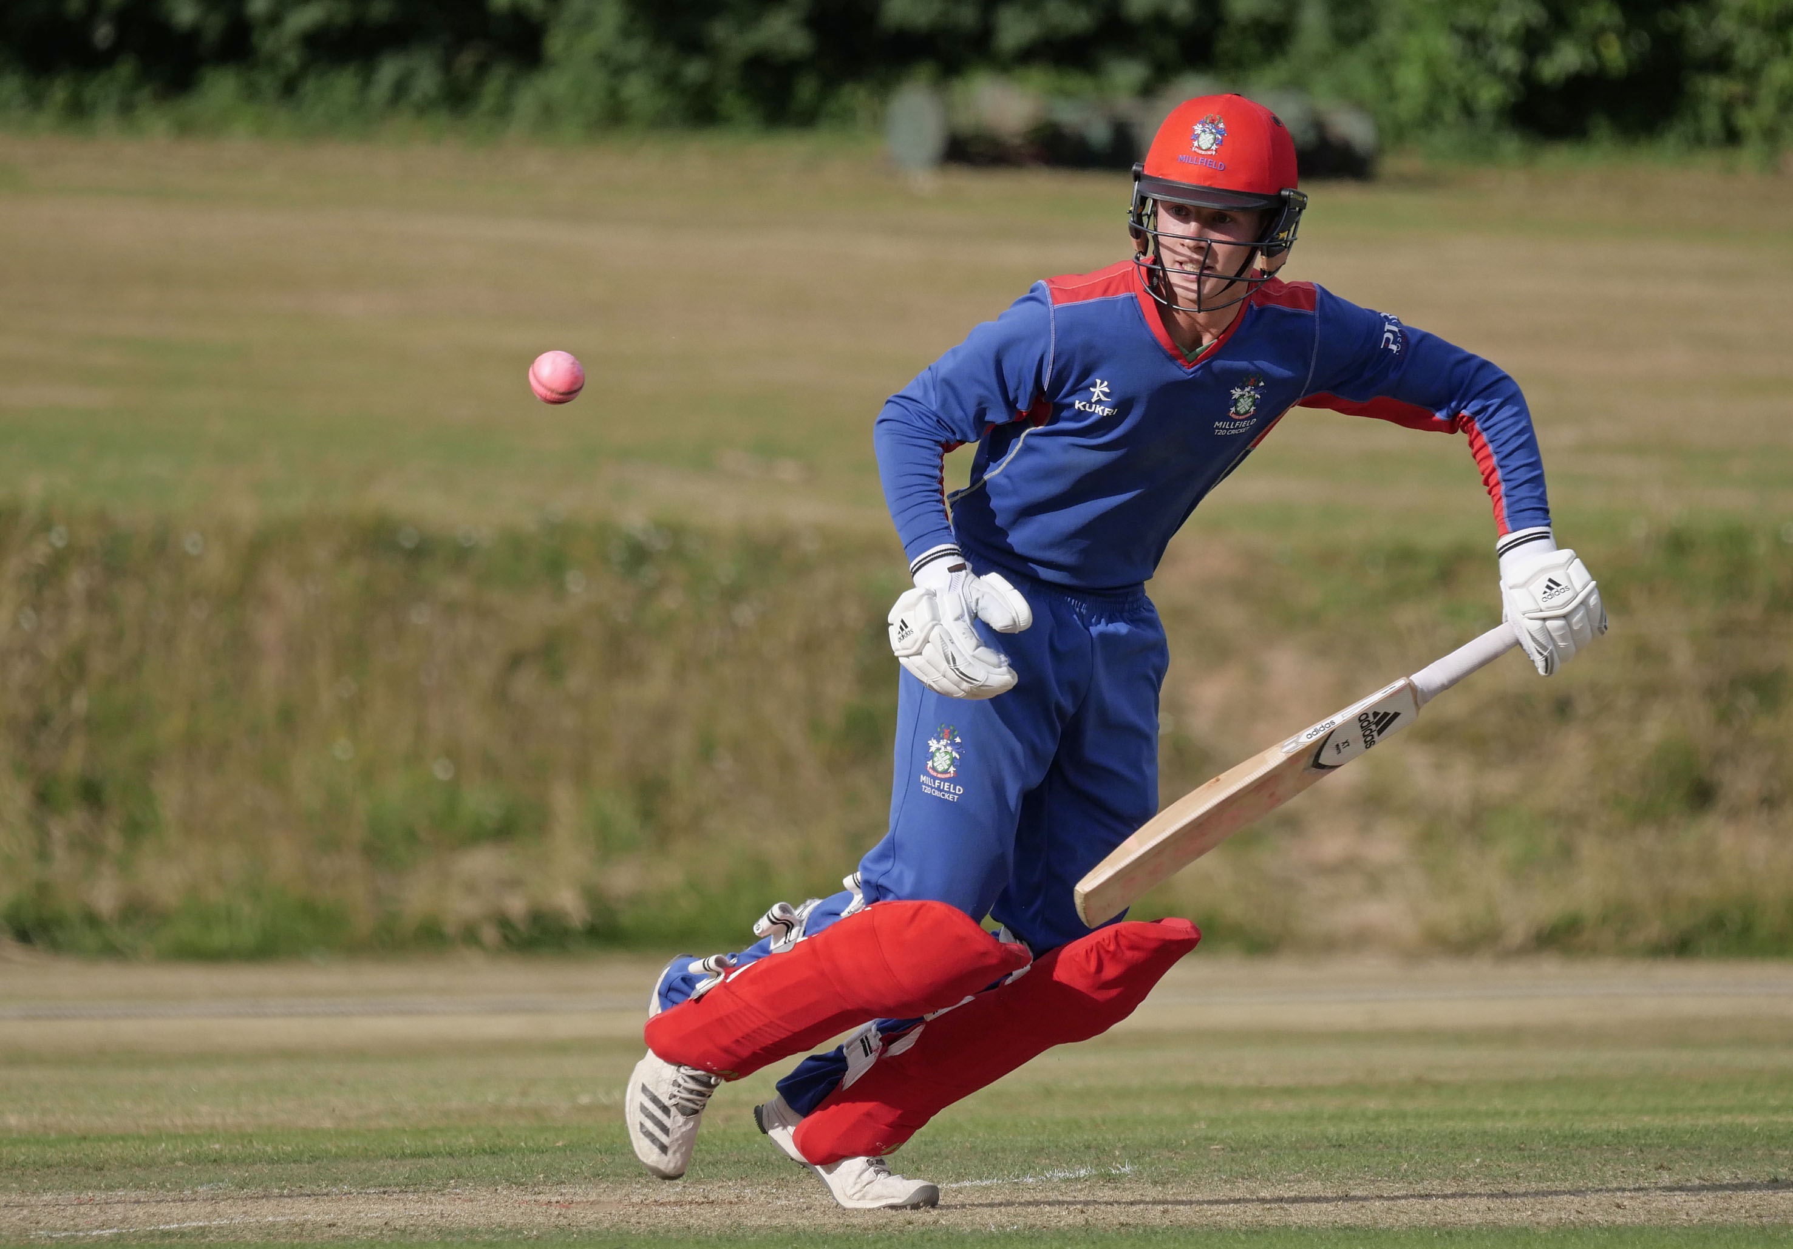
Millfield captain, Thomas Bevan, who made 53 not out

Slide 38
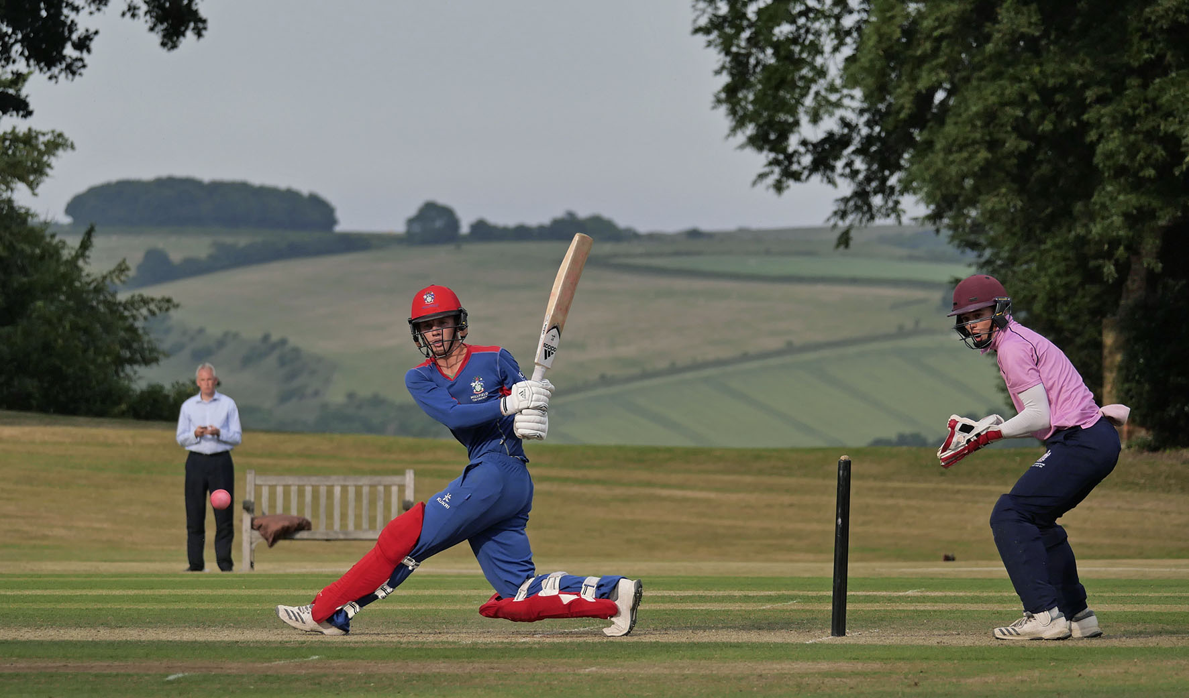
Thomas Bevan the Millfield captain hits a four

Slide 39
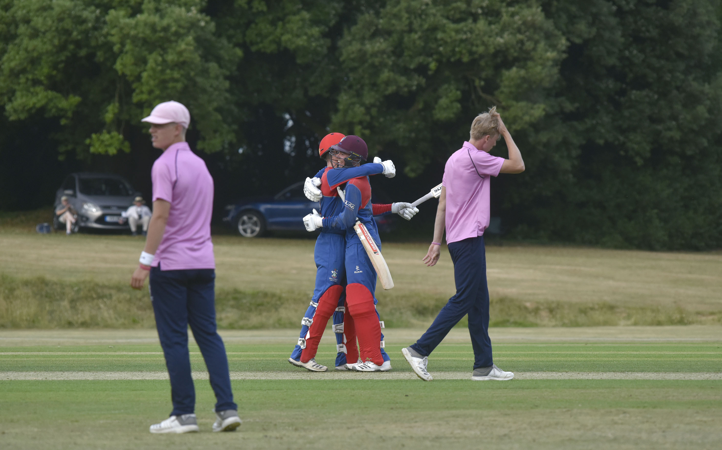
Thomas Bevan and Marcus Critchley celebrate the victory.

Slide 40
The presentation
David Graveney chatting to the runners-up Charterhouse

Slide 41
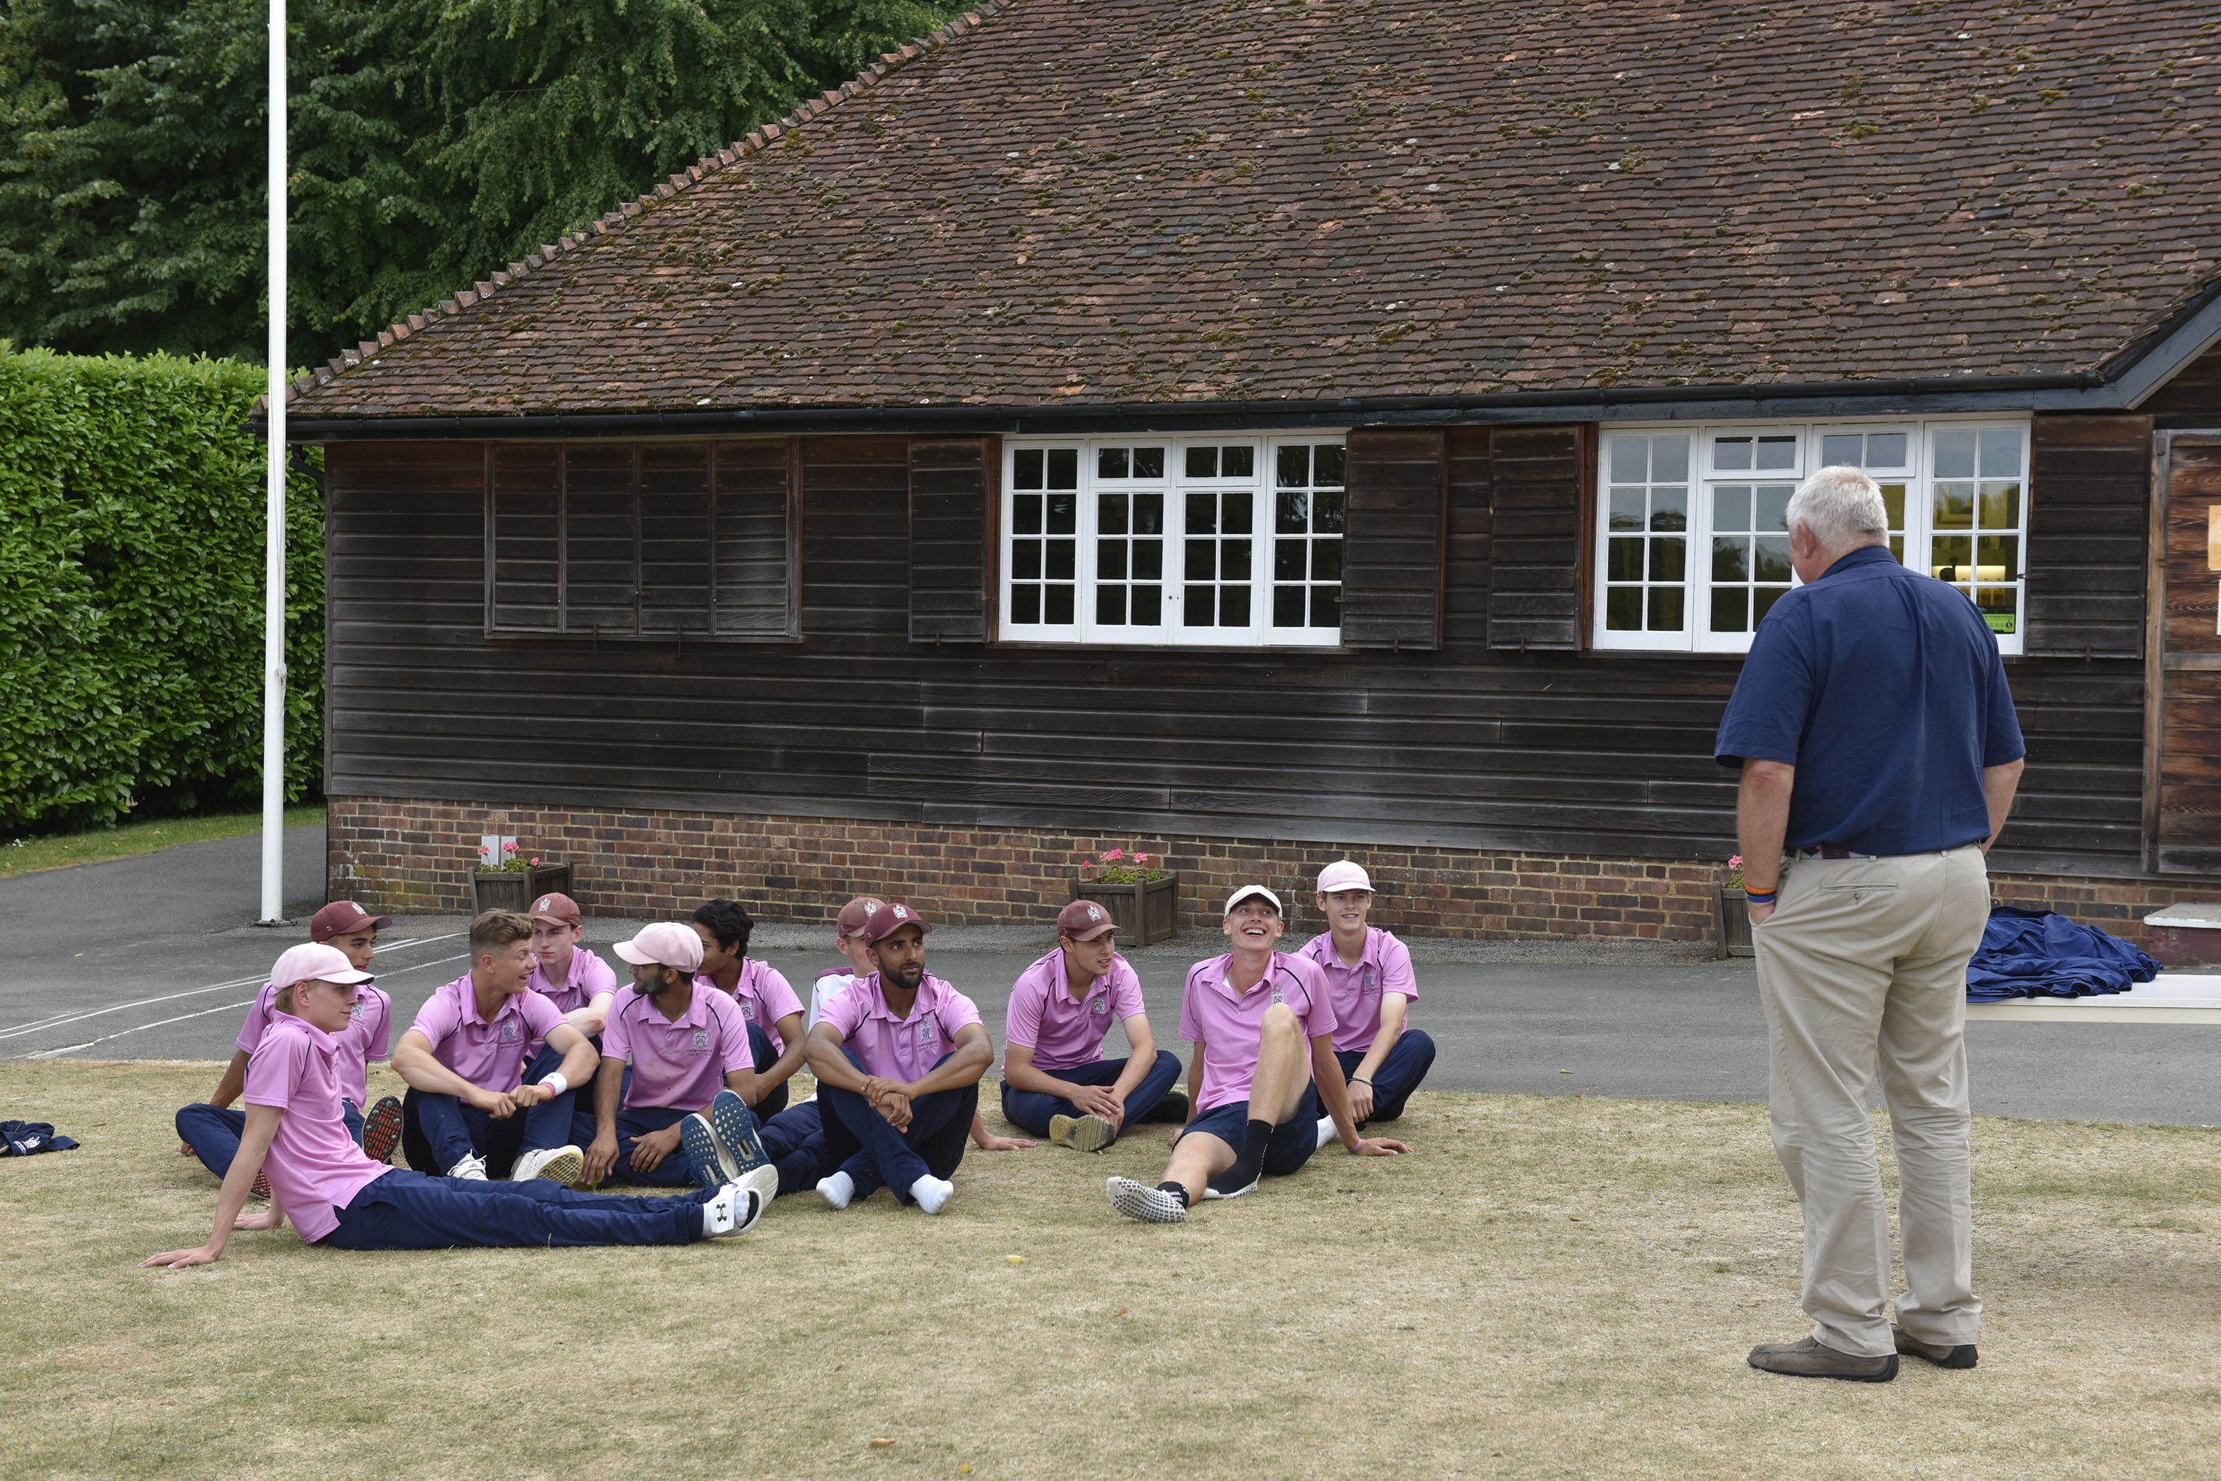
David Graveney commiserates with the Charterhouse team at the presentation ceremony

Slide 42
The presentation
David Graveney presenting the trophy to the winners
Millfield

Slide 43
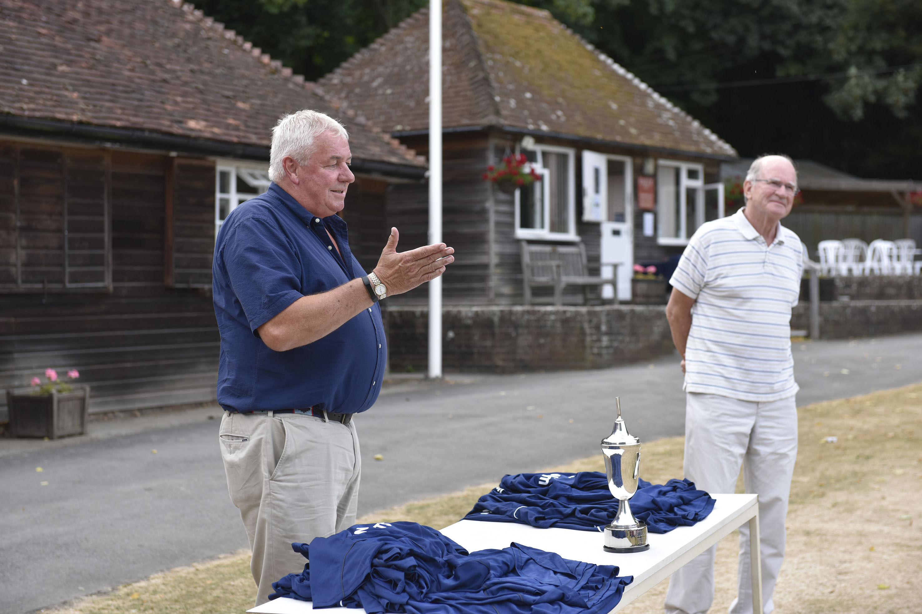
David Graveney speaking at the presentation with Douglas Henderson in the background

Slide 44
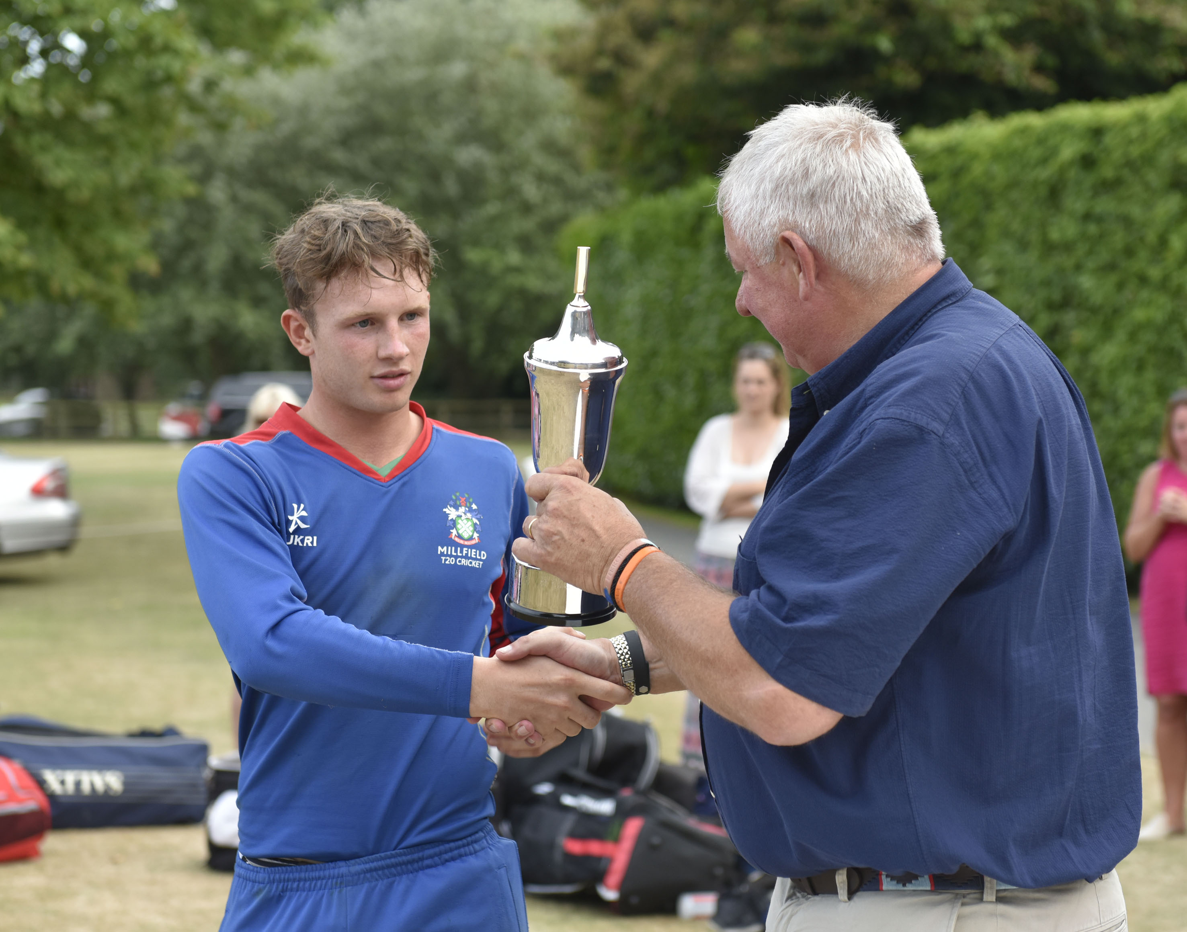
David Graveney presents the trophy to Tom Bevan, the Millfield captain

Slide 45
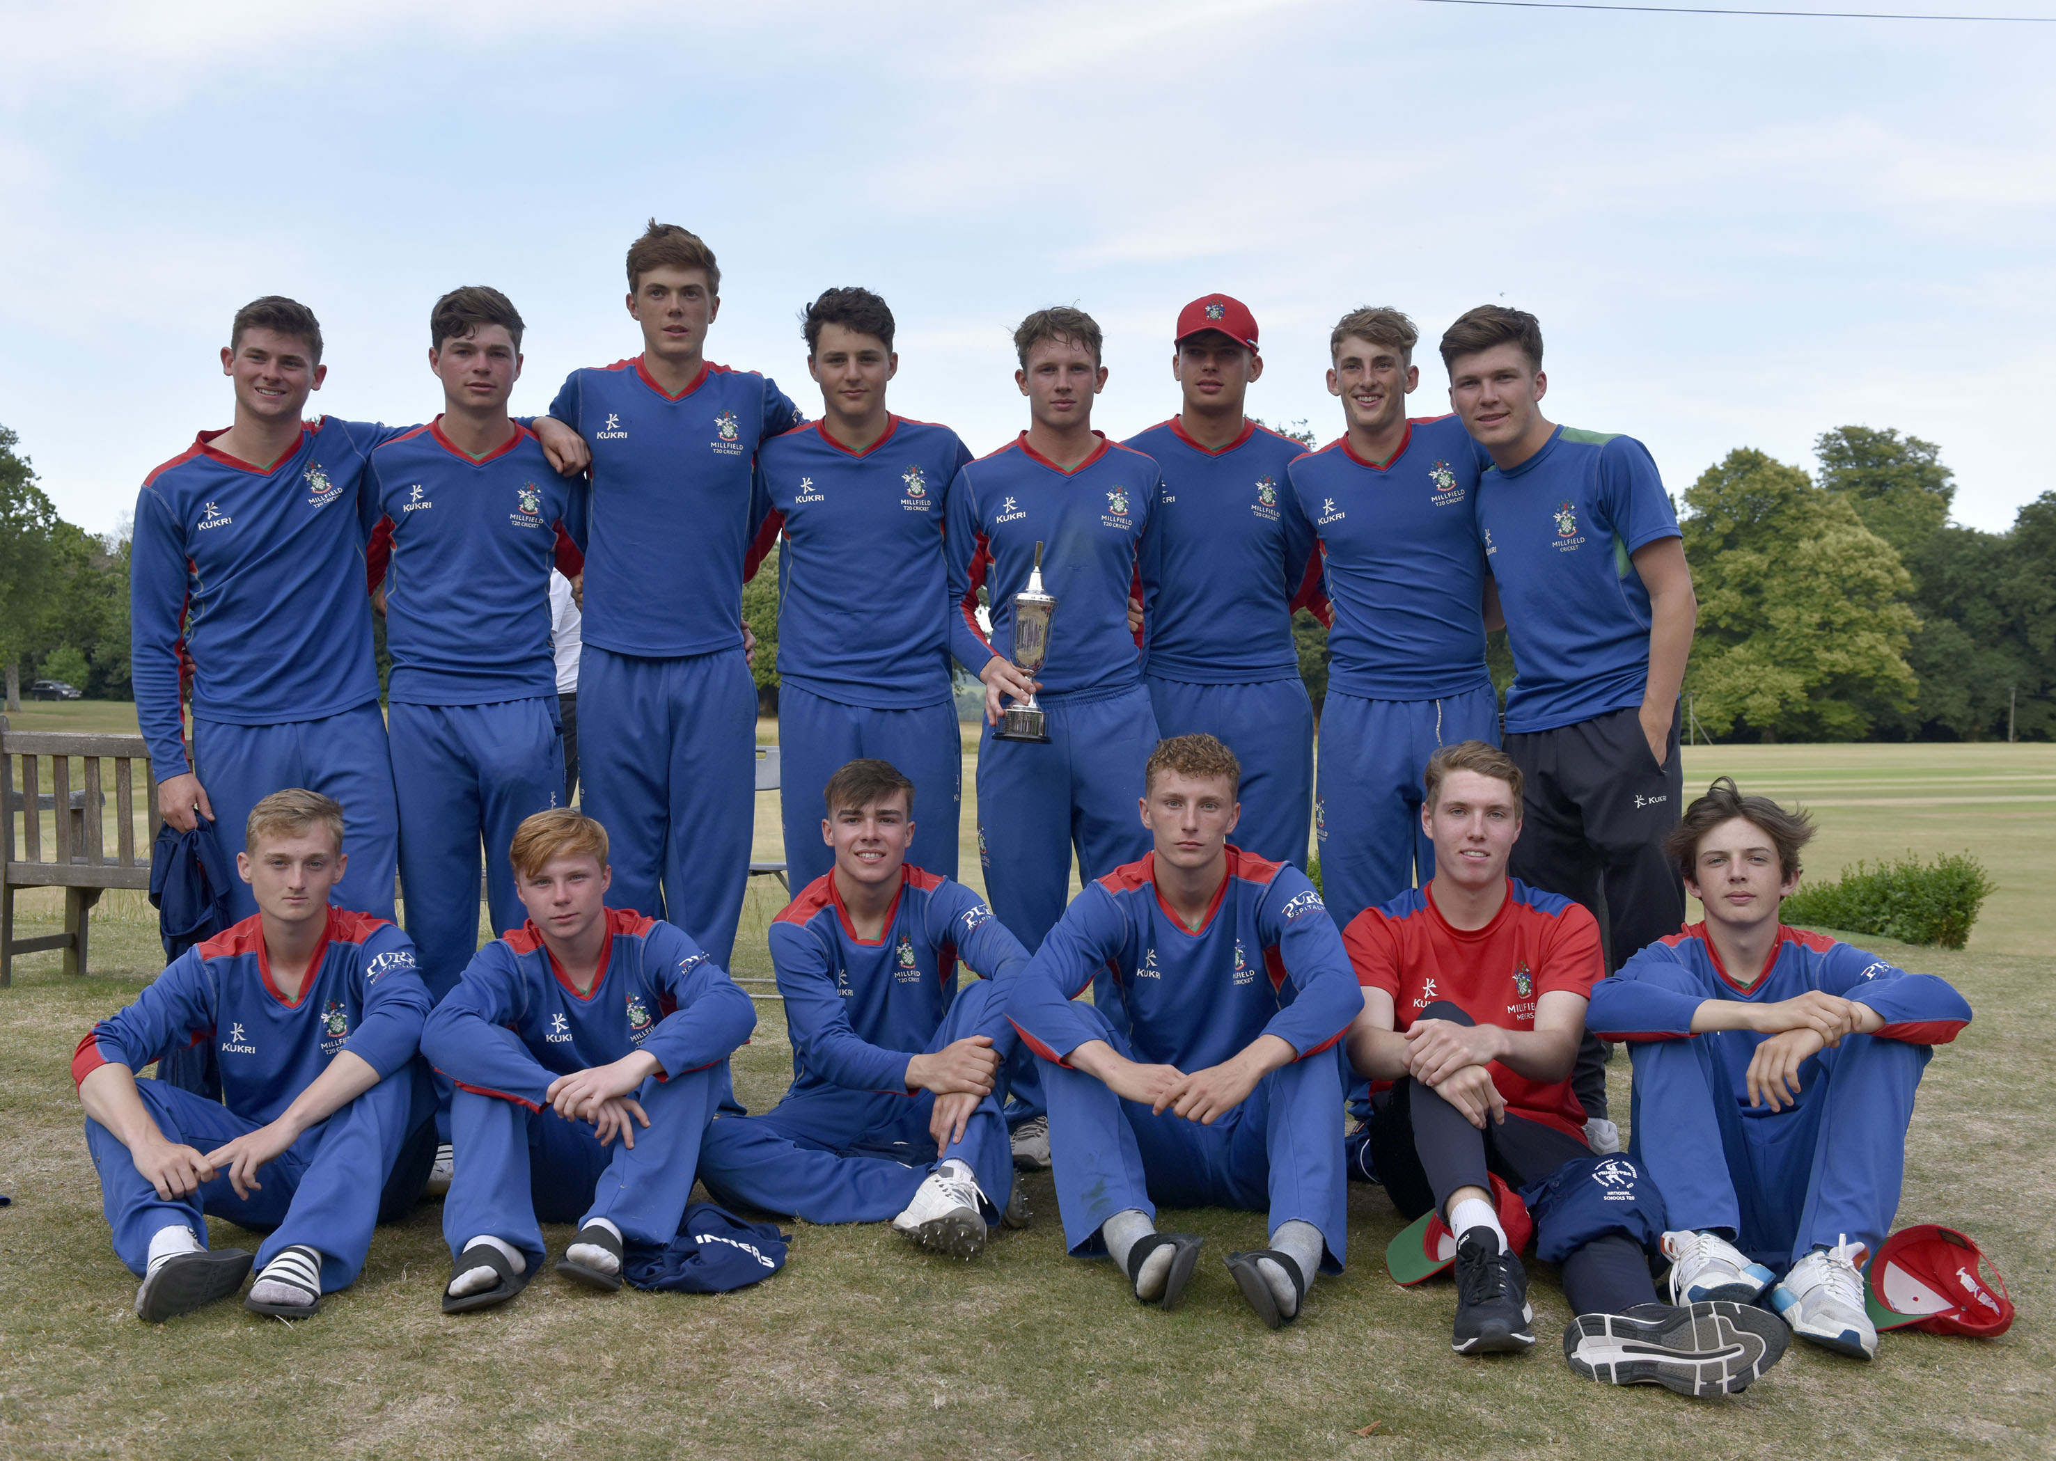
The winning Millfield team

Slide 46
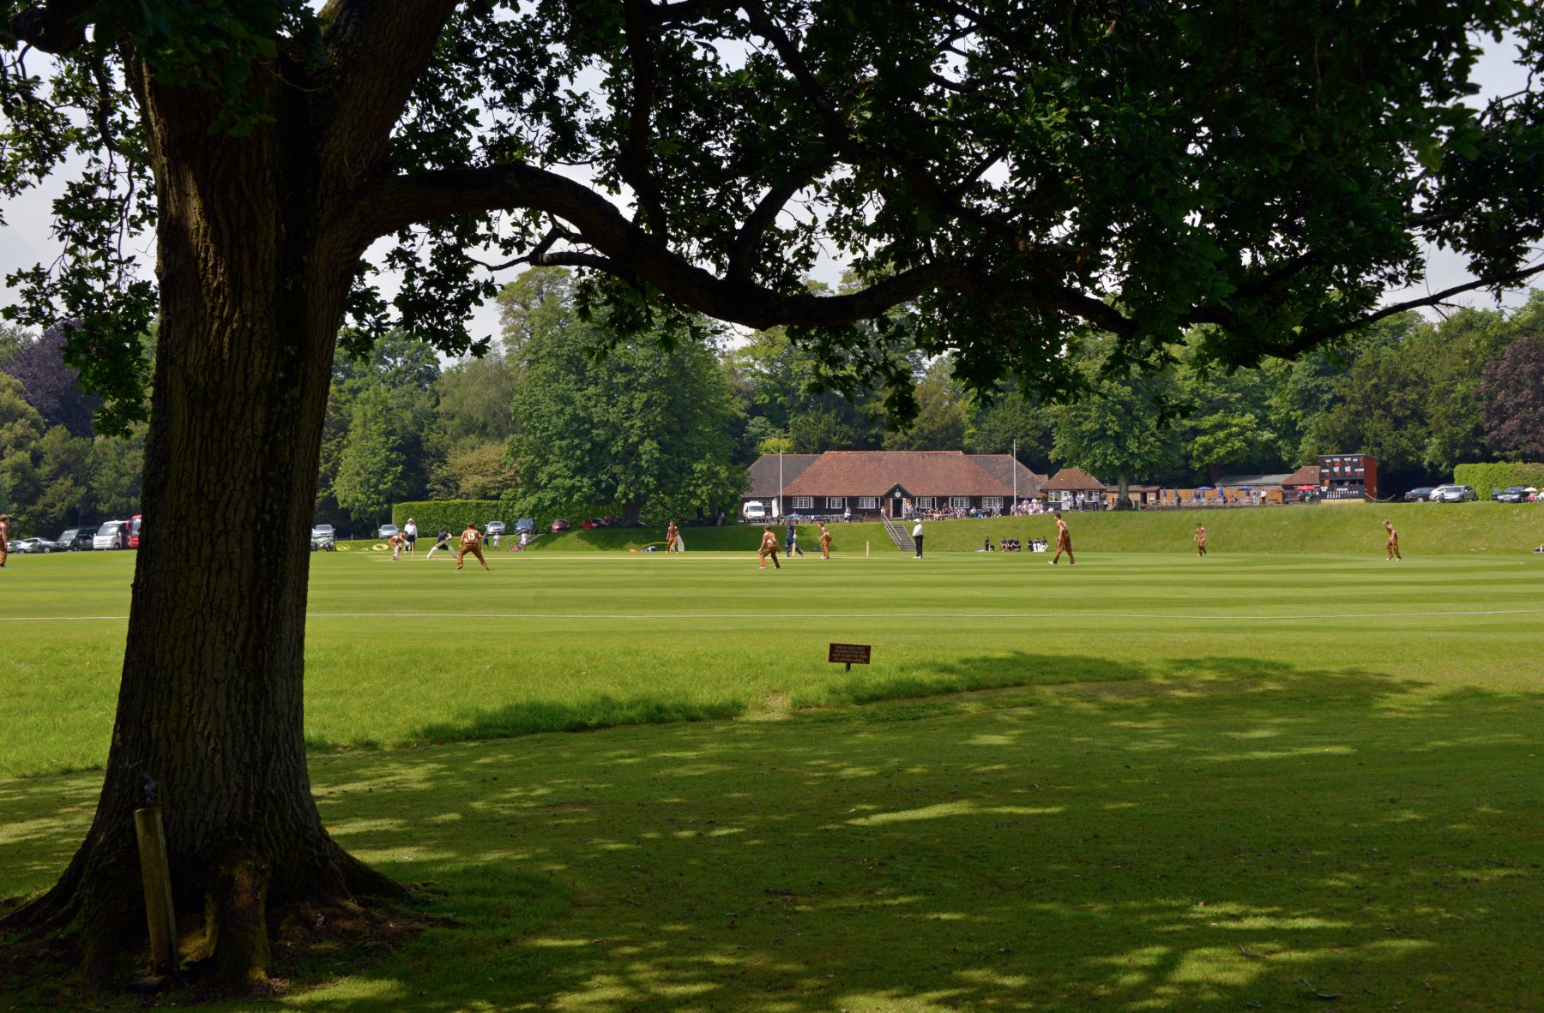

Slide 47
Photographs
by
Patrick Eagar
© No images may be reproduced without permission

